Slide 1
Securing Applications with OWASP Application Security Verification Standard 4.0
Andrew van der Stock
September 2019
Day 1

Slide 2

About OWASP
The Open Web Application Security Project (OWASP) is a 501(c)(3) worldwide not-for-profit charitable organization focused on improving the security of software.
Our mission is to make software security visible, so that individuals and organizations worldwide can make informed decisions about true software security risks.
Everyone is free to participate in OWASP and all of our materials are available under a free and open software license. You'll find everything about OWASP linked from our wiki and current information on our OWASP Blog.
https://owasp.org

Slide 3

Andrew van der Stock
Senior Principal Consultant, Synopsys
OWASP Board member 2015-2018
OWASP ASVS co-lead
OWASP Top 10 co-lead
OWASP Developer Guide 2.0 lead
Family, cats, WRC nut

Slide 4

Who are you?
Name
Role
Serial number (joking)
What are your biggest challenges?
What do you want out of the course?
This Photo by Unknown Author is licensed under CC BY-NC-ND

Slide 5
Agenda

Slide 6
Agenda Day 1
Morning
Afternoon
V4 Access Control
V4 Access Control Lab
V5 Validation and Encoding
V5 Validation and Encoding Lab (tbc)
Introductions
About ASVS
Incorporating ASVS into your development lifecycle
V1 Architecture
V2 Authentication
V3 Session Management
V2 and V3 Lab

Slide 7
Agenda Day 2
Morning
Afternoon
V8 Data Protection
V8 Data Protection Lab
V9 Communications Security
V9 Communications Security Lab
V10 Malicious Code
V10 Malicious Code Lab
V5 Validation and Encoding Lab (cont)
V6 Cryptography at rest
V6 Cryptography Lab
V7 Logging and Error Handling
V8 Logging lab

Slide 8
Agenda Day 3
Morning
Afternoon
V13 API and Web Services
V13 API Lab
V14 Configuration
V14 Configuration Lab
Secure Code Warrior Tournament
References and Wrap Up
V11 Business Logic Flaws
V11 Business Logic Flaws Lab
V12 Files and Resources
V12 Files and Resource Lab

Slide 9
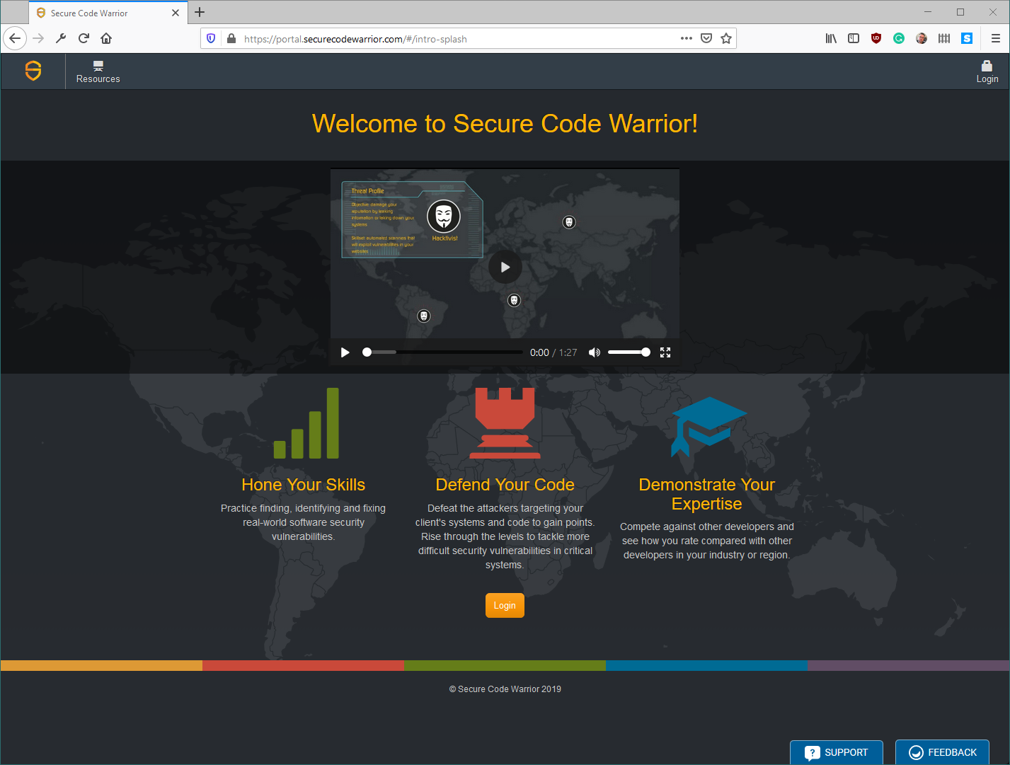
Thanks Secure Code Warrior for the labs!

Slide 10
OWASP Application Security Verification Standard 4.0
Web Application Technical Security Controls, Unleashed!

Slide 11
What is the Application Security Verification Standard?
First application security standard by developers, for developers
Each item is a single concept
Each item is testable, some more than others
Completely open source and forkable
Can be used in many ways
Adopted by many governments, large corporations, secure supply chain procurement agreements, and referenced by Relevant standards

Slide 12

Why not just use the OWASP Top 10?
Awareness only
Insufficient for secure software
Contains ~ 50 CWEs and categories (not 10)
Not written for developers
Not easily testable
Difficult to comply
Whack a mole!
Doesn’t tell you what to do, but rather what not to do.
More than 1100 “do not do X” CWEs
This Photo by Unknown Author is licensed under CC BY-NC-ND

Slide 13

Developers are security folks
DevSecOps means no more penetration tests at the end
Let’s make sure the system is tested every single build
Work with security folks to build security in
This Photo by Unknown Author is licensed under CC BY-SA

Slide 14

Security folks are developers
Learn to code
Use the same tool chain
The future is not
Test only at the end
Two-four week engagements
Low business impact
Highly technical
PDF reports
This Photo by Unknown Author is licensed under CC BY-SA

Slide 15
Bringing everyone together
Business
Scrum folks
Developers
Security
Testers
DevOps

Slide 16

Level 1: Just basics - Easily Automated
Level 1 contains 136 controls
Far better than the OWASP Top 10
Minimum acceptable assurance
Level 1 insufficient to build a secure application
Easy to automate using tools
This Photo by Unknown Author is licensed under CC BY-SA
Notes:
Rather talk about what L1 isn't and then go into L2. Too much on the screen otherwise

Slide 17

Level 2: Recommended Level
Level 2 contains 267 controls
Some controls are one-time activities
Have a secure SDLC
Use source code revision control
Use a defect tracker
Use repeatable, secure deployment
Includes secure SDLC and architecture
Most can be unit and / or integration tested
This Photo by Unknown Author is licensed under CC BY-SA-NC
Notes:
L2 is where we feel most apps should strive to be at

Slide 18
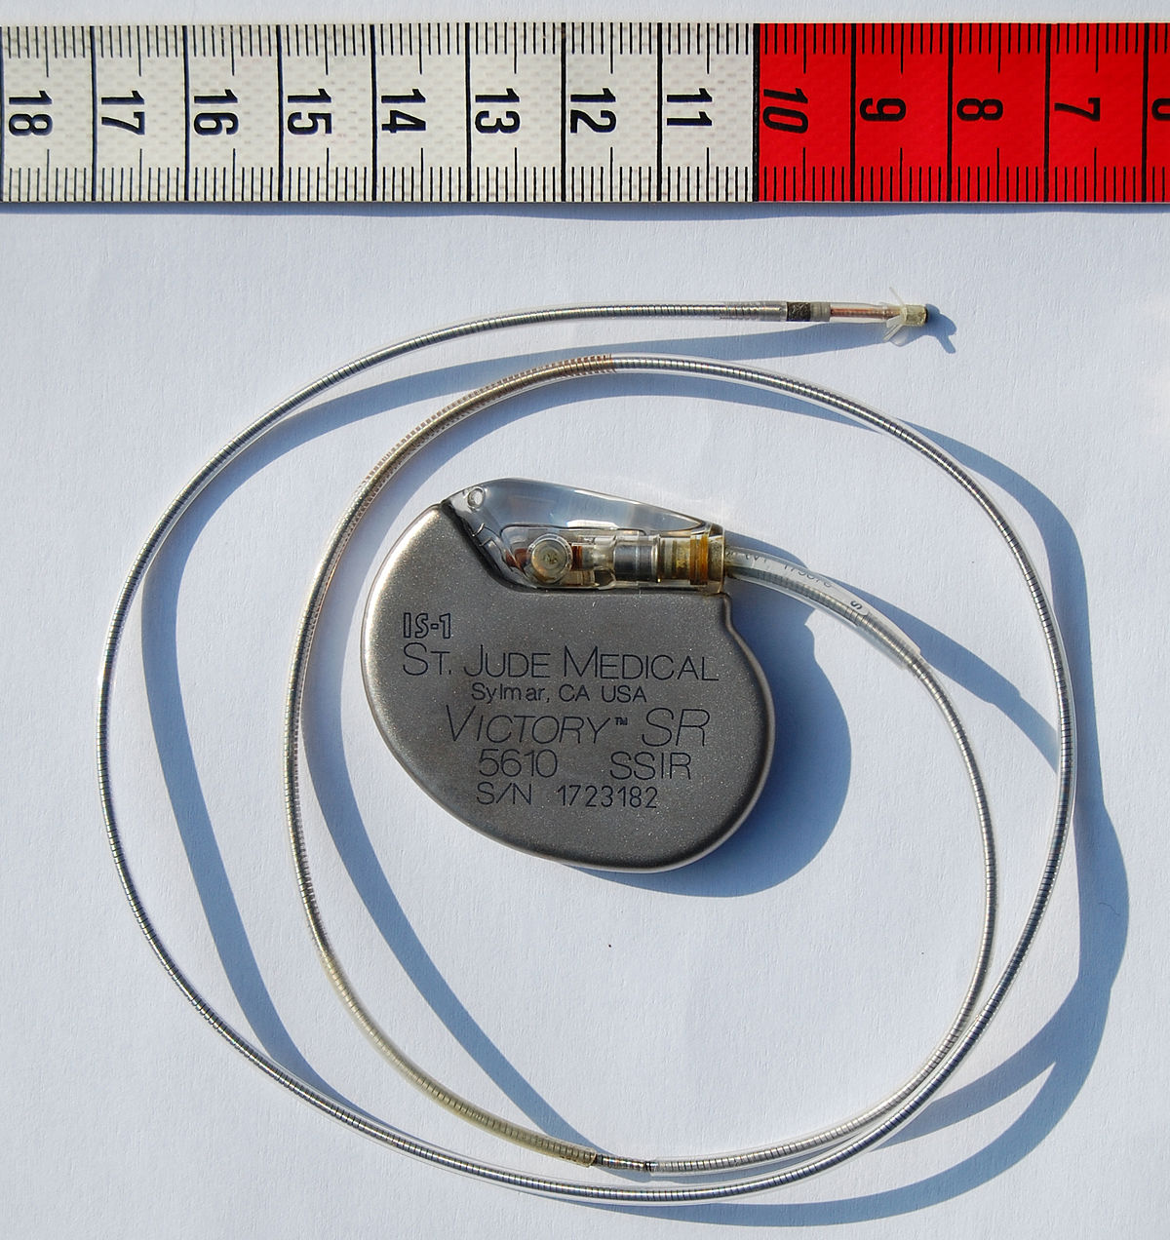
Level 3: For apps that can kill you or destroy the economy
Level 3 contains all 286 controls, suitable for:
Medical applications and devices
Above level 1 car automation
Operational technology (OT – power, water, sewage, chemical plants, nuclear power stations, etc)
Command and control software
Financial applications that could significantly ruin the planet’s economy
Level of assurance is maximum
Level of paranoia is high
This Photo by Unknown Author is licensed under CC BY-SA

Slide 19
Not every item in ASVS is in this training
ASVS contains nearly 300 items
OWASP Top 10 2017 ~ 50 items
PCI DSS 3.2.1 ~ 10 items
We can’t do them all in three days
Focus:
Developer focus
Testing focus
Secure code review focus
Penetration tester focus
DevOps focus in V1 and V14
Not focus:
Networking
Infrastructure

Slide 20
Adopting ASVS within your SDLC

Slide 21
Olden days vs new days
Waterfall (and some Wagile)
Today’s agile (and some Wagile)
Analyze Business Requirements
High level design
Detailed design
Coding
Testing
QA
* Penetration test if you were unlucky
Production
Updates every 18-36 months
No requirements as business sits with the development team (hah!)
Planning Sprints replace HLD and DD
Write some tests, coding, close ticket
Push to prod 1-100 times a day
Little to no documentation
Can’t really do security tests of each build

Slide 22
Planning in security in agile
Planning spike
You Are Gonna Need It (YAGNI)
Developers are engineers
Building secure software
Design for security
Protect
Detect
Resilient
Retrospectives
User stories
Peer reviews
Use cases with constraints
Integration tests
Abuse cases
TDD - Unit tests

Slide 23
Threat modelling 101
Threats
Components
Communication pathways
Trust boundaries
Processing
Data stores
Users
Abuse cases
Hostile user stories
Functional security features
Non-functional security features
Web threats (no motivation)

Slide 24
Three Key Questions
How do we reduce the number of security vulnerabilities in our applications?
How do we reduce the time and resources required to perform risk analysis and threat modeling?
How do we measure, view and respond to application security risks?
Notes:
Idea here is to have them ask these questions at every stage of the project. Not just once, but every new commit, etc.

Slide 25
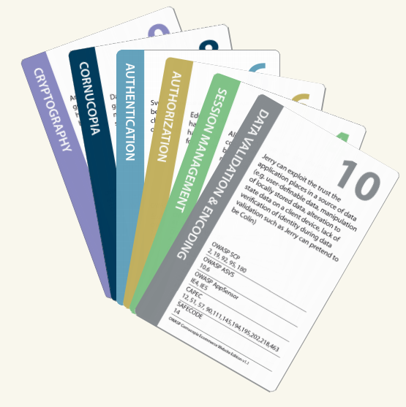
OWASP Cornucopia
Aligned with web app risks
Let’s play the game
Can download for free
Can buy from OWASP Merchandising Store

Slide 26
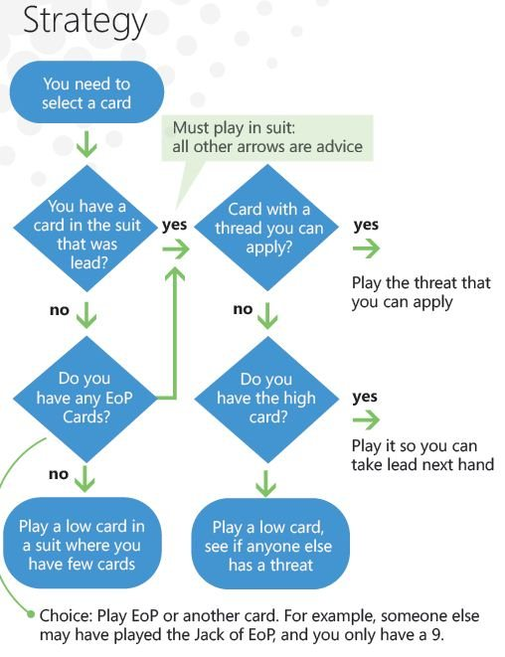
Elevation of privilege
Aligned with Microsoft SDL
Let’s play the game
Can buy from Microsoft
Can download and print

Slide 27
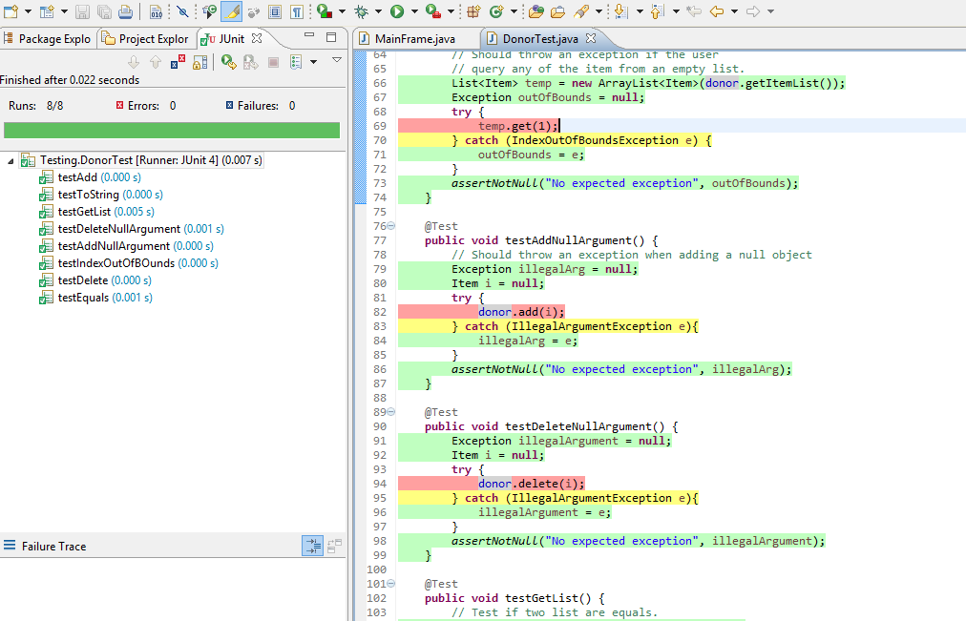
Using ASVS to help with unit tests
Write unit tests to validate your application every build
Allows penetration testers to concentrate on difficult to automate tests, such as business logic flaws, access control issues, and things you forgot in the unit tests
This Photo by Unknown Author is licensed under CC BY-SA

Slide 28
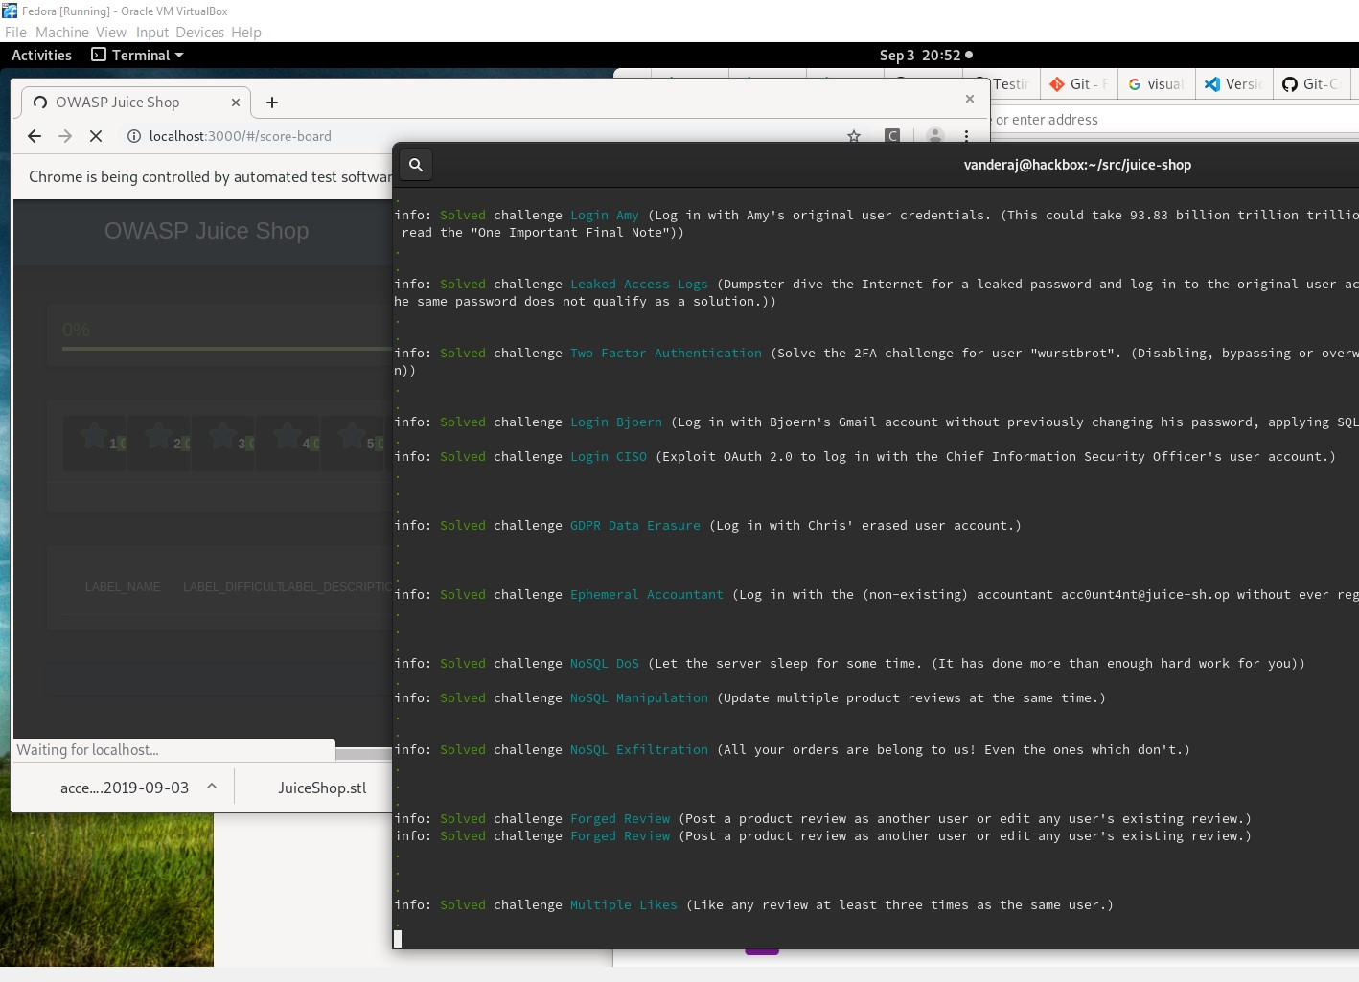
Using ASVS to help with integration tests
End to end testing is critical
Replicate penetration tests
Works every build
Selenium
Postman
Protractor
Robot Framework

Slide 29
How to fork and use ASVS
Let’s fork
Notes:
Maybe add why some might need to do this? It doesn't work for all

Slide 30
Lab: Fork ASVS
Install GitHub Desktop
Clone https://github.com/OWASP/ASVS/
You now have a forked copy

Slide 31
Keep up to date with upstream
git remote add upstream https://github.com/OWASP/ASVS
git fetch upstream
git checkout master
git merge upstream/master

Slide 32
Contribute back
Create pull requests (either in Github itself, or via CLI)

Slide 33
Modifying the ASVS
It’s in Markdown. You can change anything with a text editor
Feel free to change the text for your local requirements
Feel free to delete items.
Don’t renumber items.
Add your local items as “x.y.50” and on up

Slide 34
Translating the ASVS
Create a fork in Github
Create your local language directory (pt_br, jp, it)
Translate one chapter and item at a time
Spell and grammar check your translation
Confirm that the English and your translation mean the same thing
Create a pull request to have your translation added to the official repo

Slide 35
Baffled? We are too. Ask questions
There’s a lot of items in the ASVS.
If it’s confusing to you in your language or you can’t translate it, it’s likely to be confusing in English as well
If it’s bizarro control, create a GitHub issue and we’ll address it in the master
Ask for explanations on OWASP Slack

Slide 36
Lab Setup

Slide 37
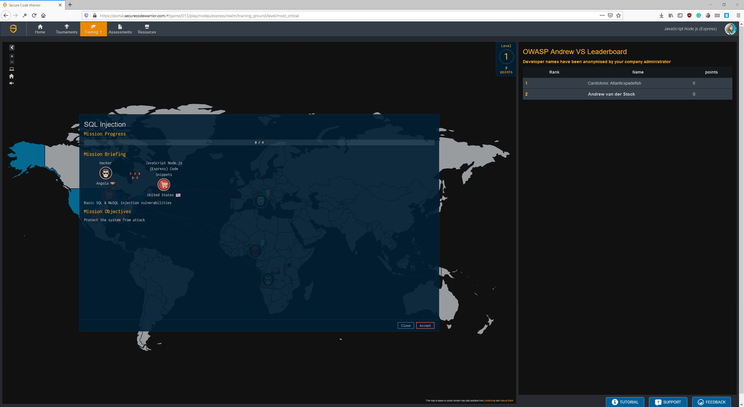
Secure Code Warrior Setup
Gaining access to the lab
Pick a language
Let’s pick a lab together
Create a fix
Test the result

Slide 38
Architecture
Design security in

Slide 39

What is Security Architecture
Architectural principles
Secure design patterns
Shared secure component design and re-use
Expects ~25% architecture change every 3-5 years
Addresses current and future threats
This Photo by Unknown Author is licensed under CC BY-ND

Slide 40

Benefits of a security architecture
Stands the test of time
Reduces refactoring costs
Aligns business risk with costs
Reduces losses from breaches
Protects financials and shareholder value
Privacy and data protection
Reduces regulatory risks
Reduces reputation losses
This Photo by Unknown Author is licensed under CC BY-SA

Slide 41

Security architecture goals
Secure by default implementation
Re-use secure components
Segmentation and loose coupling
Confidentiality
Integrity
Availability
Non-repudiation
Detection and response
Resilience
Secure by default configuration
Testable security
This Photo by Unknown Author is licensed under CC BY-SA

Slide 42
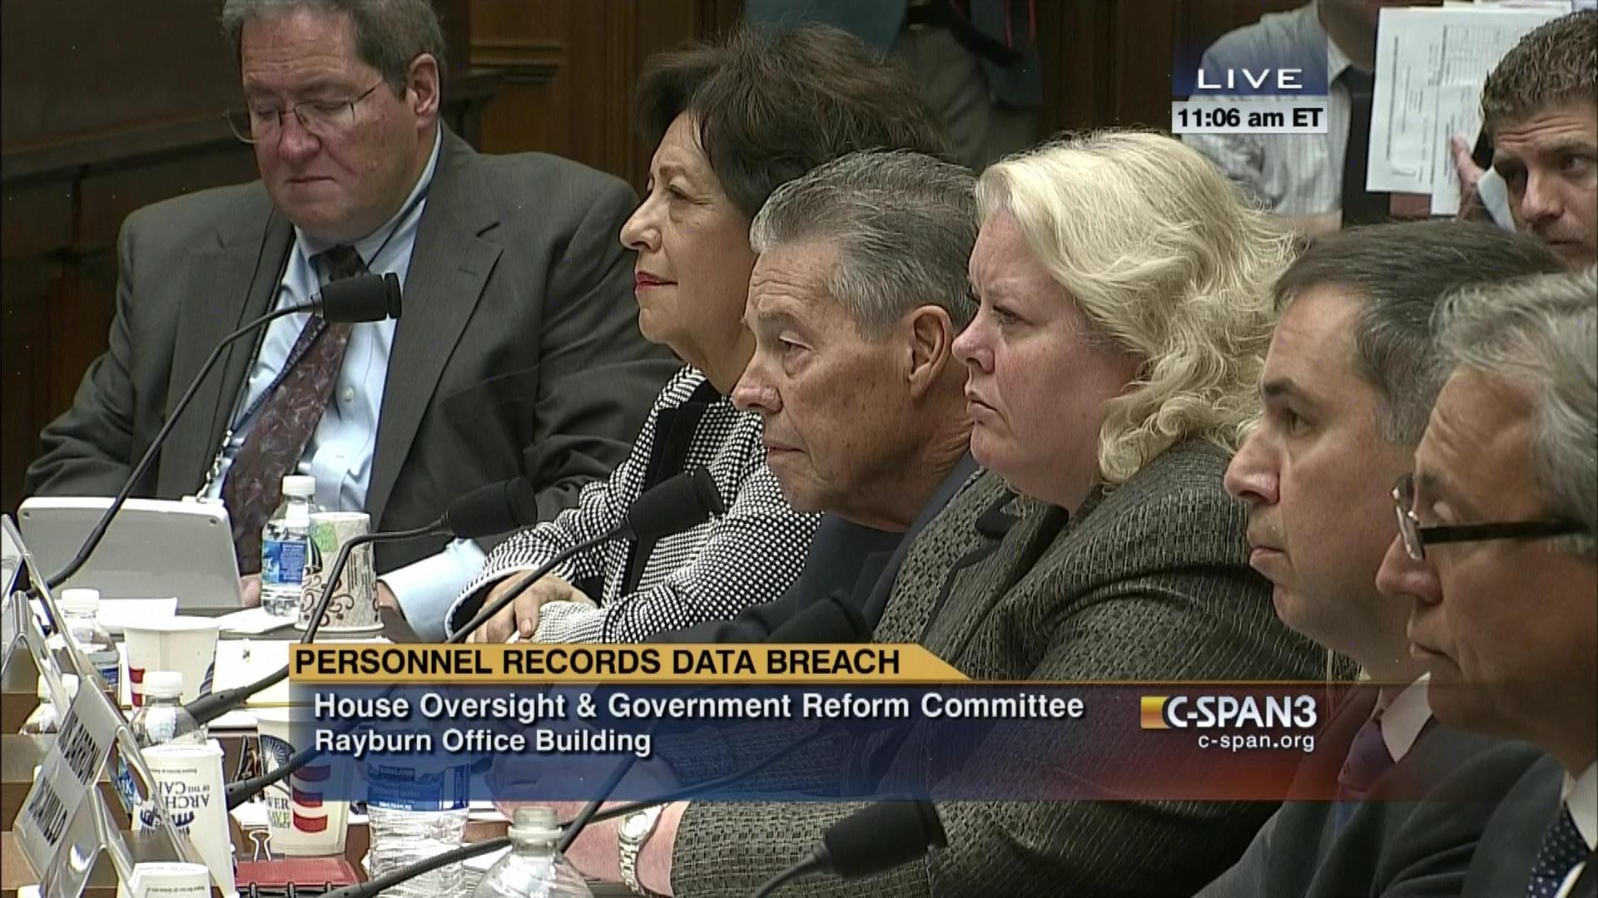
Some past breaches
Office of Personnel Management – the personnel record, background checks, and fingerprints of every Federal Government employee and contractor, including spies, law enforcement agents, judges, and many senior heads of departments.
Equifax 2017 – 147.9 million records, including credit history, SSN, identity proofing, driver’s licenses and more
Yahoo 2013 – 3 billion passwords

Slide 43
1.1.1 Secure SDLC
Verify the use of a secure software development lifecycle that addresses security in all stages of development.
Rationale
Just like scalability and performance, security has to be built in
Secure SDLC happens continuously
Everyone is a part of the SDLC
RIP “security sits to the side”. You will not be missed
Relevant standards
OWASP Proactive Controls C1 Define Security Requirements
NIST 800-53 SA-3 (High priority)
Recommended solutions
Pick a secure SDLC
Create a maturity action plan to adopt it systemically over time
Educate developers and business on secure SDLC
Architecture Review
Ensure that a SDLC is defined
Ensure that the SDLC has security activities throughout all phases
Ensure that developers are trained in secure SDLC techniques

Slide 44
1.1.2 Use threat modelling
Verify the use of threat modeling for every design change or sprint planning to identify threats, plan for countermeasures, facilitate appropriate risk responses, and guide security testing.
Rationale
Abuse cases don’t generate themselves
Threat modelling helps understand how critical data assets can be attacked
Understand the trust boundaries of all your components
Relevant standards
OWASP Proactive Controls C1
NIST 800-53 SA-17
Recommended solutions
Attend threat modelling talks at AppSec DC
Learn how to perform threat models
Document threat models in Confluence or similar
Create and update threat models with new tickets
Architecture Review
Review threat models for completeness
Review abuse cases and constraints
Ensure that there are unit and integration tests present related to threat models
Choose a sampling of these to determine if they could prevent or detect the documented threats

Slide 45
1.1.3 Security constraints for all
1.1.3 Verify that all user stories and features contain functional security constraints, such as "As a user, I should be able to view and edit my profile. I should not be able to view or edit anyone else's profile“
Rationale
Abuse cases and security constraints are usually functional requirements
Functional requirements are testable
Relevant standards
OWASP Top 10
OWASP Proactive Controls C1
NIST 800-53 SA-17
Recommended solutions
Write security constraints and abuse cases for each user story, task or issue
“As a user, I should not be able to view or change anyone else’s profile”
“As an administrator, I should be able to view and change anyone’s profile, but such viewing and changes should be auditable”
Architecture Review
Review user stories for presence of abuse cases and constraints
Review tickets to determine if constraints were considered during implementation
Review the implementation to determine if the constraints were coded
Review test cases to determine if the constraints are tested

Slide 46
1.1.4 Documented trust boundaries
Verify documentation and justification of all the application's trust boundaries, components, and significant data flows.
Rationale
Understand who can send you malicious data
Understand who might consume malicious data
Understand the sorts of controls necessary at these boundaries (authentication, access control, input validation, output
Relevant standards
OWASP Top 10
OWASP Proactive Controls C1
NIST 800-53 SA-17
Recommended solutions
Create a list of all components
Place in an architecture diagram
Document data sources
Document users of data sources
Document data sinks
Document consumers of data sinks
Architecture Review
Review if the documented design includes trust boundaries
Sample the trust boundaries to determine if they are present in the code or configuration
Sample code or interview to identify if the trust boundaries are up to date

Slide 47
1.1.5 High level architecture
Verify definition and security analysis of the application's high-level architecture and all connected remote services.
Rationale
Conceptual integrity
Reduce re-work due to dead ends
Understand security boundaries
Document architectural assumptions
Relevant standards
OWASP Proactive Controls C1
NIST 800-53 SA-17
Recommended solutions
If waterfall, BDUF
Agile avoids BDUF, document your architecture as you go
Ensure the architecture is updated as code and configuration is updated
Architecture Review
Review architecture and design documentation
Sample the documentation to ensure it is up to date
Review the documentation to determine if it has sufficient depth and accurately describes the code

Slide 48
1.1.6 Economy of design
Verify implementation of centralized, simple (economy of design), vetted, secure, and reusable security controls to avoid duplicate, missing, ineffective, or insecure controls.
Rationale
Re-use saves time and money
Fewer components requires less verification
Less code == less bugs
Relevant standards
OWASP Proactive Controls C2
NIST 800-53 SA-17
Recommended solutions
Review code for any duplicated mechanisms (e.g. authentication, data)
Refactor to use the best one
Architecture Review
Review the application for any duplicated security mechanisms in authentication, session management, access control, input validation, output encoding, cryptography, logging, and so on

Slide 49
1.1.7 Uses a secure coding checklist
Verify availability of a secure coding checklist, security requirements, guideline, or policy to all developers and testers.
Rationale
You don’t know what you don’t know
Reduces costs and re-work
Reduces whack-a-mole security
Relevant standards
OWASP Proactive Controls C1
NIST 800-53 SA-17
Recommended solutions
Use OWASP Proactive Controls if just starting
Use ASVS L1 and build up to L2 over time
Include with peer code reviews and retrospectives
Architecture Review
Establish if a secure coding checklist exists
Review if developers use it

Slide 50
1.8.1 Classify data
Verify that all sensitive data is identified and classified into protection levels.
Rationale
Don’t over classify
Don’t under classify
No point spending money
Relevant standards
OWASP Proactive Controls C1
NIST 800-53 SA-17
Recommended solutions
Use enterprise’s classification policy
If none exists, review ISO 27002 or the DHS Cyber Risk Framework
Create one
Label data, preferably with one of three “public, private, sensitive”
Decide on classification data protection requirements. Even public has integrity and (transmission) confidentiality requirements
Architecture Review
Ensure there is a classification / data protection policy
Sample if data has been labelled and protected

Slide 51
1.8.2 Define protection requirements
Verify that all protection levels have an associated set of protection requirements, such as encryption requirements, integrity requirements, retention, privacy and other confidentiality requirements, and that these are applied in the architecture.
Rationale
Not classifying at all places you at automatic “High” risk
Underclassifying will lead to under protected data
Overclassifying will lead to unnecessary additional unnecessary expenses, and possibly slow down the system
Relevant standards
OWASP Proactive Controls C1
NIST 800-53 SA-17
Recommended solutions
Prepare data protection policies for public, private and sensitive labels (or similar)
Review app architecture for data of this type
Create a standard reference implementation to satisfy these types, building on each one
Document the results to encourage re-use
Architecture Review
Ensure that data protection requirements have been defined
Review a sample of data to ensure that these have been implemented

Slide 52
1.10.1 Use source code control
Verify that a source code control system is in use, with procedures to ensure that check-ins are accompanied by issues or change tickets. The source code control system should have access control and identifiable users to allow traceability of any changes.
Rationale
Enables collaboration and peer review
Ensures flow control, not all can push to master
Allows automation
Relevant standards
OWASP Proactive Controls C1
NIST 800-53 SA-17
Recommended solutions
Github
Gitlab (on-prem/cloud)
Bitbucket
Architecture Review
Review to see if source code control is in place

Slide 53
1.11.1 Document your design
Verify the definition and documentation of all application components in terms of the business or security functions they provide.
Rationale
Increased costs
Lack of conceptual integrity
Increased refactoring
Complete rewrite
Relevant standards
OWASP Proactive Controls C1
NIST 800-53 SA-17
Recommended solutions
Use a wiki (GitHub, Confluence, etc) to document as you go
Make sure check-in checklists include a mandatory documentation update check
Use OpenAPI (Swagger) to produce API documentation
Use JavaDoc (or similar) to produce up to date code documentation
Architecture Review
Check that documentation is present, and up to date
Sample some of the documentation to ensure that it matches the current state of the build

Slide 54
1.14.1 Loosely couple your architecture
Verify the segregation of components of differing trust levels through well-defined security controls, firewall rules, API gateways, reverse proxies, cloud-based security groups, or similar mechanisms.
Rationale
Layered security approach
You want attackers to make noise, so easier to detect
Relevant standards
OWASP Proactive Controls C1
NIST 800-53 SA-17
Recommended solutions
Design each component or API to stand alone
Design for maximal re-use
If coupling is necessary, minimize coupling complexity
Architecture Review
Review components for tight coupling
If many objects are tied together consider if refactoring might make sense

Slide 55
1.14.5 Sandbox and containerize
Verify that application deployments adequately sandbox, containerize and/or isolate at the network level to delay and deter attackers from attacking other applications, especially when they are performing sensitive or dangerous actions such as deserialization.
Rationale
Attackers use large attack surface to find additional exploits
Attackers want to move laterally
Attackers want persistence on compromised assets
Relevant standards
OWASP Proactive Controls C1
NIST 800-53 SA-17
Recommended solutions
Containerize as many elements as possible
Make each container locally stateless
For large scale backends (DBMS, etc) consider sharding and scale out
Architecture Review
Review if sandboxing is in place
Ensure that the design is containerized

Slide 56
Labs
Let’s create a threat model together
Notes:
Idea: get them first to describe an app they are working on currently for their day job. Use this as the basis for the TM

Slide 57
Authentication

Slide 58

What is authentication?
If your name isn't down, you aren't coming in!
These are the keys the house. Incredibly important, make life miserable if you lose them and yet so many struggle with keeping their keys secure.

Slide 59
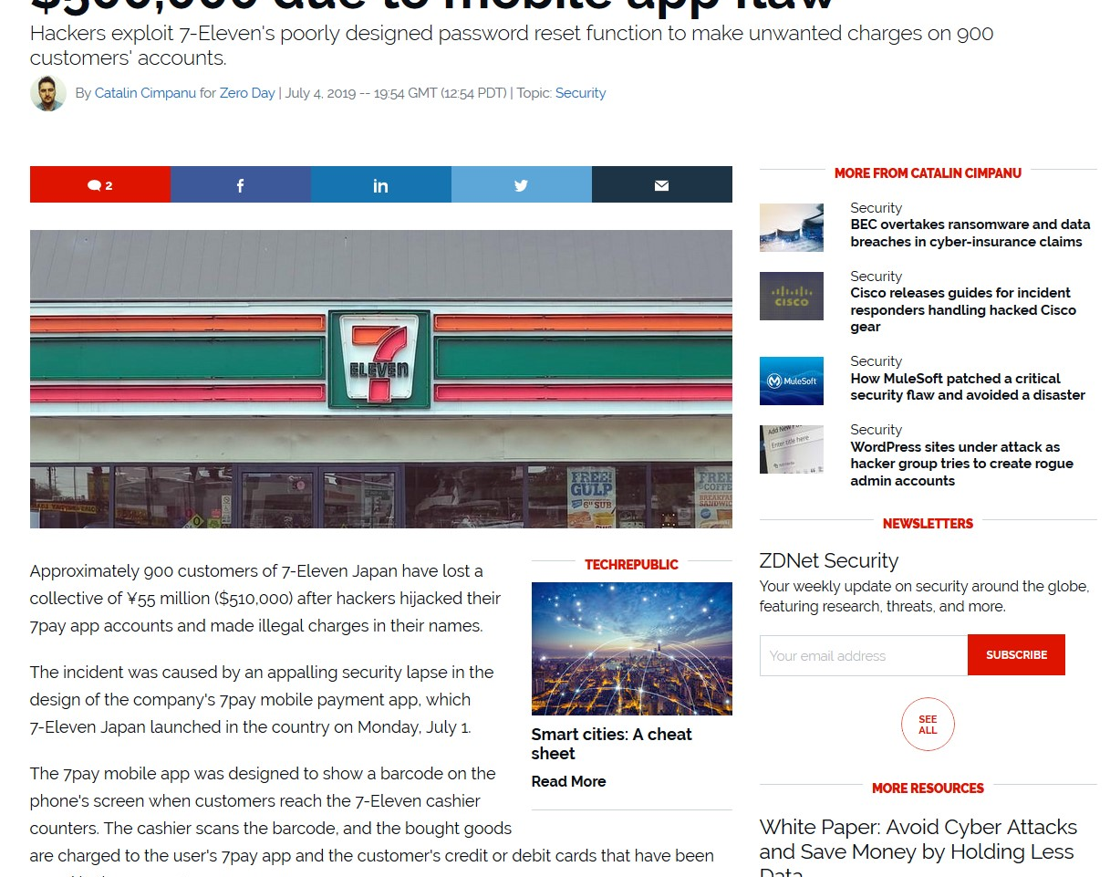
Some past breaches
Have I been Pwned has 8,465,989,585 breached credentials (more than 1 for every single person on the planet)
TransUnion HK “secure questions”
7-Elevent 7pay password reset flaw
Chegg weak passwords on 40 million users (unsalted MD5)
MyFitnessPal breach 150 m users with SHA1 passwords
Fortigate VPN magic backdoor
Notes:
CVE-2018-13382 https://fortiguard.com/psirt/FG-IR-18-389

Slide 60
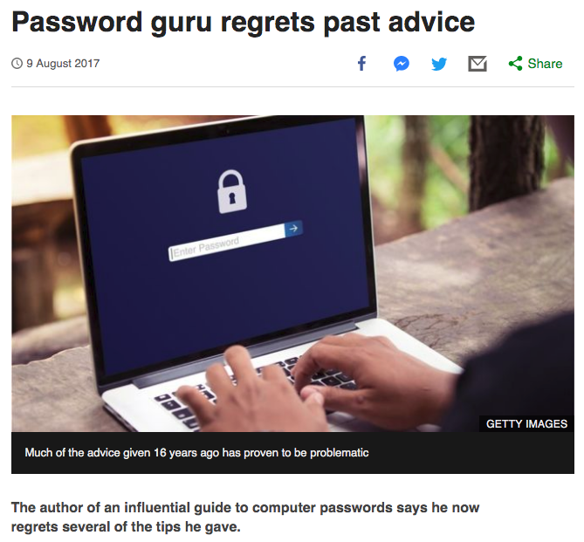
Poor Legacy Advice
We need to help create frictionless security. A key part of that journey is about user credentials.
Bill Burr had advised users to change their password every 90 days
to muddle up words by adding capital letters, numbers and symbols
Mr Burr now acknowledges that his 2003 manual was "barking up the wrong tree".

Slide 61
1.2.1 Low privilege service accounts
Verify the use of unique or special low-privilege operating system accounts for all application components, services, and servers.
Rationale
Allows complete compromise of all data
May allow control of the service
Allows (sometimes) lateral movement
Relevant standards
OWASP Top 10 A2
OWASP Proactive Controls C6
NIST 800-63 x.x.x
PCI DSS 6.5.10
NIST 800-53 AC-2
Recommended solutions
Use a low privilege account
Unit Tests
Try to execute a privileged operation, such as drop table or similar – should fail
Architecture Review
Ensure there is a policy around the creation, maintenance and monitoring of service accounts
Sample one or two service accounts to determine if this policy is in place and effective
Ensure service accounts are not default accounts and unique to the application or service

Slide 62
2.1.1 Sufficiently long passphrases
Verify that user set passwords are at least 12 characters in length.
Rationale
Short passwords are trivially recovered
Short passwords are typically re-used
Encourages adoption of passphrases – or even better, password managers
Relevant standards
OWASP Top 10 A2
OWASP Proactive Controls C6
NIST 800-63 x.x.x
PCI DSS 6.5.10
NIST 800-53 AC-2
Recommended solutions
Prevent less than 12-character passwords
Unit Tests
AuthenticationService > setNewPassword
fails when password length < 12
passes when password length >= 12
End to end integration tests
Insert < 11 character password, should fail
>= 12 character password, should pass

Slide 63
2.1.10 No periodic changes
Verify that there are no periodic credential rotation or password history requirements.
Rationale
This has NEVER worked
Comes from 1979 paper on password cracking times on a PDP 11
You cannot change passwords fast enough today
Causes weak passwords and patterns
Passwords on post it notes
Relevant standards
OWASP Top 10 A2
OWASP Proactive Controls C6
NIST 800-63 x.x.x
PCI DSS 6.5.10
NIST 800-53 AC-2
Recommended solutions
Remove periodic change functionality
Implement breached password change functionality
If in enterprise space, provide an API for HR or link to ADFS for employee parental leave, sabbatical, retirement and separation reasons.
Unit Tests
Review tests for periodic enforced changes - fail
End to end integration tests
Review for periodic enforced changes - fail

Slide 64
2.1.11 Permit password managers
Verify that "paste" functionality, browser password helpers, and external password managers are permitted.
Rationale
Improve customer experience
Strong random passwords cannot be cracked today or any time in the next five years
Password managers are our best hope against credential stuffing
Relevant standards
OWASP Top 10 A2
OWASP Proactive Controls C6
NIST 800-63 x.x.x
PCI DSS 6.5.10
NIST 800-53 AC-2
Recommended solutions
Remove paste restrictions if implemented
Wrap username + password input fields in <form> elements. Use unique element IDs for each input field
Consider implementing biometric authentication (FaceID, Fingerprint scans, etc) on mobile applications to unlock a JWT or Oauth token, eliminating usernames and passwords entry completely
Consider integrating with common password managers on mobile platforms
Unit Tests
Not applicable
End to end integration tests
Use “Paste” functionality in web and mobile test suites to paste in invalid and valid usernames and passwords

Slide 65
2.1.12 Allow user to reveal password
Verify that the user can choose to either temporarily view the entire masked password, or temporarily view the last typed character of the password on platforms that do not have this as native functionality.
Rationale
Improve customer experience
Reduce soft lockouts
Relevant standards
OWASP Top 10 A2
OWASP Proactive Controls C6
NIST 800-63 x.x.x
PCI DSS 6.5.10
NIST 800-53 AC-2
Recommended solutions
Use a reveal widget on web pages
Automatically hide after x number of seconds, say 10 or so
Use default password field on mobile platforms
Unit Tests
Not applicable
End to end integration tests
Test that reveal password function reveals the field and hides it after a short duration

Slide 66
2.1.2 No upper limit on password length
Verify that passwords 64 characters or longer are permitted.
Rationale
There is no technical reason why not
Only a small percentage will use long pw
Hashed passwords always take fixed storage lengths
Relevant standards
OWASP Top 10 A2
OWASP Proactive Controls C6
NIST 800-63 x.x.x
PCI DSS 6.5.10
NIST 800-53 AC-2
Recommended solutions
Hash + salt passwords
Don’t worry about length
Unit Tests
Test for 63, 64, 128 and 2k passwords
All should work
End to end integration tests
Test for 63, 64, 128 and 2k passwords
All should work

Slide 67

2.1.4 が大好き.
Verify that Unicode characters are permitted in passwords. A single Unicode code point is considered a character, so 12 emoji or 64 kanji characters should be valid and permitted.
Rationale
Unicode and Emoji is generally not in any password lists
CX will be awesome
English is spoken by only 1.5 billion people
Relevant standards
OWASP Top 10 A2
OWASP Proactive Controls C6
NIST 800-63 x.x.x
PCI DSS 6.5.10
NIST 800-53 AC-2
Recommended solutions
Remove or don’t implement password complexity validators
Unit Tests
Test that Unicode and emoji passphrases and passwords work
Test 0, 11, 12, 13, 64 code point passwords
End to end integration tests
Test that Unicode and emoji passphrases and passwords work
Test 0, 11, 12, 13, 64 code point passwords

Slide 68
2.1.5 Users must be able to change credentials
Verify users can change their password.
Rationale
Well, duh.
Relevant standards
OWASP Top 10 A2
OWASP Proactive Controls C6
NIST 800-63 x.x.x
PCI DSS 6.5.10
NIST 800-53 AC-2
Recommended solutions
Implement a password change feature
Unit Tests
Test password change
Includes old password, new and confirm - pass
Missing old password – fail
Missing new or confirm – fail
Mismatch new or confirm - fail
End to end integration tests
Validate that users change password functionality per unit tests

Slide 69
2.1.6 Verify the old password
Verify that password change functionality requires the user's current and new password.
Rationale
Prevents attackers abusing password change function
Confirms user identity (to a degree)
Relevant standards
OWASP Top 10 A2
OWASP Proactive Controls C6
NIST 800-63 x.x.x
PCI DSS 6.5.10
NIST 800-53 AC-2
Recommended solutions
When changing passwords, ensure that the old password is the actual old password
Unit Tests
User change password
Missing old password - fail
Wrong old password - fail
Correct old password - pass
End to end integration tests
User change password
Missing old password - fail
Wrong old password - fail
Correct old password - pass

Slide 70
2.1.7 Breached password detection
Verify that passwords submitted during account registration, login, and password change are checked against a set of breached passwords either locally (such as the top 1,000 or 10,000 most common passwords which match the system's password policy) or using an external API. If using an API a zero knowledge proof or other mechanism should be used to ensure that the plain text password is not sent or used in verifying the breach status of the password. If the password is breached, the application must require the user to set a new non-breached password.
Rationale
We have 8 billion of your usernames + passwords already
Let’s not use those again
Relevant standards
OWASP Top 10 A2
OWASP Proactive Controls C6
NIST 800-63 x.x.x
PCI DSS 6.5.10
NIST 800-53 AC-2
Recommended solutions
Use a local or remote breached password check
When using a remote API, make sure it’s zero knowledge
Update local breach lists regularly from SecLists
Unit Tests
Test a known breached password (“Password1!”)
Test a known safe password
End to end integration tests
During login
Generating random initial passwords
Enrolment – set initial password
Credential recovery – set replacement password
User or admin change password – set new password

Slide 71
2.1.9 No composition rules
Verify that there are no password composition rules limiting the type of characters permitted. There should be no requirement for upper or lower case or numbers or special characters.
Rationale
THEY HAVE NEVER EVER WORKED
Even the 1979 paper that led to composition rules thought they were weak
Relevant standards
OWASP Top 10 A2
OWASP Proactive Controls C6
NIST 800-63 x.x.x
PCI DSS 6.5.10
NIST 800-53 AC-2
Recommended solutions
Eliminate composition rules
Enforce length rules
Unit Tests
Test passwords with all lower case or all upper case or all numbers
End to end integration tests
Test passphrases consisting only of lower case letters

Slide 72
2.2.1 Authentication anti-automation
Verify that anti-automation controls are effective at mitigating breached credential testing, brute force, and account lockout attacks. Such controls include blocking the most common breached passwords, soft lockouts, rate limiting, CAPTCHA, ever increasing delays between attempts, IP address restrictions, or risk-based restrictions such as location, first login on a device, recent attempts to unlock the account, or similar. Verify that no more than 100 failed attempts per hour is possible on a single account.
Rationale
Credential stuffing (and credential oracles)
Limiting business losses and reputation damage
Attackers have excellent fuzzing and brute force tools
Human time is vastly different to fuzz time
Many times, anti-automation provides sufficient protection
Relevant standards
OWASP Top 10 A2
OWASP Proactive Controls C6
NIST 800-63 x.x.x
PCI DSS 6.5.10
NIST 800-53 AC-2
Recommended solutions
OWASP Automated Threats to Web Applications
Use features of WAFs and Web Service Gateways
Build in anti-automation countermeasures
Technical limits per user, method, IP, business limits
Monitoring
Instrumentation
Contract
Response
Sharing
Unit Tests
Try to call a sampling of sensitive methods such as enrolment, login, or transferring funds
Test anti-automation limits such as exceeding enrolment thresholds
Test responses
End to end integration tests
Try to enroll a thousand times – it should fail
Try to login ten times fast with real creds – it should slow down and then stop

Slide 73
2.2.2 Use push authenticators or better
Verify that the use of weak authenticators (such as SMS and email) is limited to secondary verification and transaction approval and not as a replacement for more secure authentication methods. Verify that stronger methods are offered before weak methods, users are aware of the risks, or that proper measures are in place to limit the risks of account compromise.
Rationale
SMS / SIM swap attacks
SMS is over SS7, which has precisely zero security
Email is (typically) clear text transmission and storage
Relevant standards
OWASP Top 10 A2
OWASP Proactive Controls C6
NIST 800-63 x.x.x
PCI DSS 6.5.10
NIST 800-53 AC-2
Recommended solutions
Use TOTP or FIDO for authenticators
Enrol in push notifications for multifactor validation
If the user can’t enroll in push notifications, use email or SMS or both
Don’t send sensitive information over email and SMS
Unit Tests
Test functional MFA or federated login
Test functional push, SMS, and email
End to end integration tests
Enrol and test functional MFA or federated login
Enrol and test functional push, SMS, and email

Slide 74
2.2.3 Notify users after account changes
Verify that secure notifications are sent to users after updates to authentication details, such as credential resets, email or address changes, logging in from unknown or risky locations. The use of push notifications - rather than SMS or email - is preferred, but in the absence of push notifications, SMS or email is acceptable as long as no sensitive information is disclosed in the notification.
Rationale
Users are the best “free” IDS
Users can respond if they only knew
Relevant standards
OWASP Top 10 A2
OWASP Proactive Controls C6
NIST 800-63 x.x.x
PCI DSS 6.5.10
NIST 800-53 AC-2
Recommended solutions
Send push (and email or SMS at worst) notifications after account changes
Password change
Email change (to old and new)
Phone change (to old and new)
Address change
High value business changes (i.e. disbursement accts)
Unit Tests
Test functional push notifications
Test functional email notifications
Test functional SMS notifications
End to end integration tests
Test functional push notifications
Test functional email notifications
Test functional SMS notifications

Slide 75
2.3.1 Generate random initial passwords
Verify system generated initial passwords or activation codes SHOULD be securely randomly generated, SHOULD be at least 6 characters long, and MAY contain letters and numbers, and expire after a short period of time. These initial secrets must not be permitted to become the long-term password.
Rationale
Static initial passwords like “admin” or “123456” are rife
We have payloads containing thousands of these
Relevant standards
OWASP Top 10 A2
OWASP Proactive Controls C6
NIST 800-63 x.x.x
PCI DSS 6.5.10
NIST 800-53 AC-2
Recommended solutions
Generate a random password for every new user, including the initial administrator account
Should comply with your password length policy
Force change password upon first login
Unit Tests
Generate 10,000 initial passwords
Test for sufficient entropy (randomness)
End to end integration tests
Enrol in an account n times
Compare resulting tokens to ensure that they are different

Slide 76
2.3.2 Allow users to use secure tokens they already own
Verify that enrollment and use of subscriber-provided authentication devices are supported, such as a U2F or FIDO tokens.
Rationale
Users shouldn’t have to carry multiple tokens
Most hardware tokens are far stronger than TOTP
MFA authenticator lifecycle is terrible
Relevant standards
OWASP Top 10 A2
OWASP Proactive Controls C6
NIST 800-63 x.x.x
PCI DSS 6.5.10
NIST 800-53 AC-2
Recommended solutions
Use TOTP for most systems
Support FIDO Alliance keys for most and higher value systems
Consider if federated authentication against a public IDP is for you (Ping, Okta, social networks, etc)
Unit Tests
Enrol token
Change token
Login using {fake, expired, real} token
End to end integration tests
Enrol token
Change token
Login using {fake, expired, real} token
Notes:
What about passwordless/oauth/webauthn etc? Going to talk about it?

Slide 77
2.4.1 Securely hash passwords
2.4.1 Verify that passwords are stored in a form that is resistant to offline attacks. Passwords SHALL be salted and hashed using an approved one-way key derivation or password hashing function. Key derivation and password hashing functions take a password, a salt, and a cost factor as inputs when generating a password hash.
Rationale
We can crack literally trillions of passwords per second
Most common lengths are instantaneous to not very long on certain dedicated systems
Relevant standards
OWASP Top 10 A2
OWASP Proactive Controls C6
NIST 800-63 x.x.x
PCI DSS 6.5.10
NIST 800-53 AC-2
Recommended solutions
Advice changes rapidly: Use OWASP Password Cheat Sheet
Select a random salt value
Unit Tests
Test when creating a password that two close passwords have very different hashes.
End to end integration tests
Not applicable

Slide 78
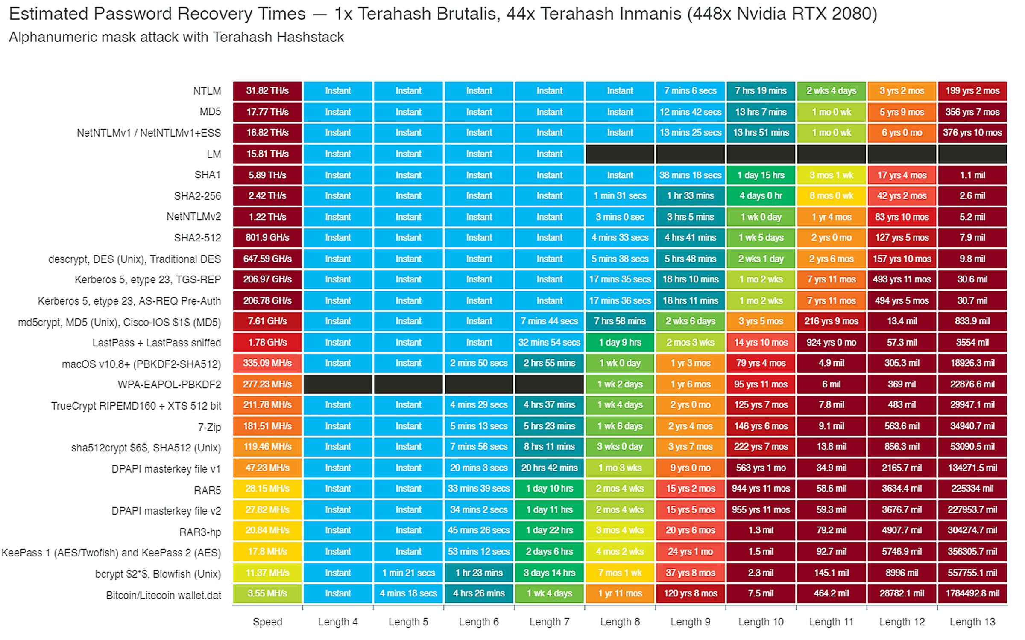

Slide 79
2.8.3 Use latest strong algorithms
Verify that approved cryptographic algorithms are used in the generation, seeding, and verification.
Rationale
Old, weak algorithms are broken
Relevant standards
OWASP Top 10 A2
OWASP Proactive Controls C6
NIST 800-63 x.x.x
PCI DSS 6.5.10
NIST 800-53 AC-2
Recommended solutions
Use standard algorithms with their recommended settings
Unit Tests
Check that encrypted input is not plain text
End to end integration tests
Not applicable

Slide 80
2.5.1 Don’t send passwords in the clear
Verify that a system generated initial activation or recovery secret is not sent in clear text to the user.
Rationale
Search almost everyone’s email account for passwords, and you’ll get one or more
Makes recovery emails very valuable
Relevant standards
OWASP Top 10 A2
OWASP Proactive Controls C6
NIST 800-63 x.x.x
PCI DSS 6.5.10
NIST 800-53 AC-2
Recommended solutions
Use time limited tokens
Tie them to that specific user
Link them to a person where possible
Unit Tests
Create a valid token
Test registration and recovery using
An expired token
A fake token
A real token, but for a different user
Try to recover or register for a different user with a valid token
End to end integration tests
Register or recover an account and fail if a clear text secret is sent to the user
Test registration and recovery pathways using expired, fake, real tokens but for a different user
Start the process of registration or recovery, gather a valid token. At the “enter token” and then “set credential” steps, try to use any other authenticated functionality

Slide 81
2.5.2 Kill knowledge-based authentication
Verify password hints or knowledge-based authentication (so-called "secret questions") are not present.
Rationale
Too easy to use OSINT to find answers
They rarely add value
Relevant standards
OWASP Top 10 A2
OWASP Proactive Controls C6
NIST 800-63 x.x.x
PCI DSS 6.5.10
NIST 800-53 AC-2
Recommended solutions
Kill it with fire
Unit Tests
fail(“Kill it with fire”)
End to end integration tests
fail(“Kill it with fire”)
Tell the lawyers you have a major privacy breach to really make sure it’s dead

Slide 82
2.5.4 No shared or default accounts
Verify shared or default accounts are not present (e.g. "root", "admin", or "sa").
Rationale
Password lists contain hundreds of thousands of these lists
Folks never login to clear out all of these
Security through obscurity never works
Relevant standards
OWASP Top 10 A2
OWASP Proactive Controls C6
NIST 800-63 x.x.x
PCI DSS 6.5.10
NIST 800-53 AC-2
Recommended solutions
Make the first account during installation dynamic, not fixed
Unit Tests
Try to login using a range of well known default accounts
If you had default accounts in the past, try to use them in your tests
End to end integration tests
Try to login using a range of well known default accounts
If you had default accounts in the past, try to use them in your tests

Slide 83
2.5.6 Secure credential recovery
Verify forgotten password, and other recovery paths use a secure recovery mechanism, such as TOTP or other soft token, mobile push, or another offline recovery mechanism.
Rationale
KBA is a clear and present danger
SMS is subject to number porting / SIM swapping
Email is often tied to these two
Relevant standards
OWASP Top 10 A2
OWASP Proactive Controls C6
NIST 800-63 x.x.x
PCI DSS 6.5.10
NIST 800-53 AC-2
Recommended solutions
Accept two consecutive TOTP tokens
Send a push notification
Notify the user that {credential, address, email, phone} change has happened
Considering limiting high value transactions for a few hours to a few days depending on what it is
Unit Tests
Try to recover B’s account with A’s pathway
Try to recover an account with wrong information
Try to recover all accounts without being discovered
End to end integration tests
Test all account recovery paths
Try to recover B’s account with A’s pathway
Try to recover an account with wrong information
Try to recover all accounts without being discovered

Slide 84
2.5.7 Identity proofing should be the same
Verify that if OTP or multi-factor authentication factors are lost, that evidence of identity proofing is performed at the same level as during enrollment.
Rationale
Answering “secret” questions is not as difficult as possessing a token
Ditto sending an SMS or email to a device
Relevant standards
OWASP Top 10 A2
OWASP Proactive Controls C6
NIST 800-63 x.x.x
PCI DSS 6.5.10
NIST 800-53 AC-2
Recommended solutions
Establish a single standard for identity proofing
Use it for all registration and recovery pathways
Unit Tests
The unit tests for identity proofing in registration and recovery should be similar or the same
End to end integration tests
The integration tests for identity proofing in registration and recovery should be similar or the same

Slide 85
2.8.6 Authenticators should be revokable
Verify physical single factor OTP generator can be revoked in case of theft or other loss. Ensure that revocation is immediately effective across logged in sessions, regardless of location.
Rationale
Certificates and passwords can be revoked and changed if broken
Biometrics can’t be revoked, so tie them to something that can be revoked
Relevant standards
OWASP Top 10 A2
OWASP Proactive Controls C6
NIST 800-63 x.x.x
PCI DSS 6.5.10
NIST 800-53 AC-2
Recommended solutions
Ensure that the current user can change their password
Ensure that the current user can change their MFA device
Ensure that if you support biometrics, it’s not just single factor
Unit Tests
changePassword() for current user
disableAccount() for current user
As user
As admin
End to end integration tests
changePassword() for current user
disableAccount() for current user
As user
As admin

Slide 86
2.10.1 No unchanging passwords or API keys
Verify that integration secrets do not rely on unchanging passwords, such as API keys or shared privileged accounts.
Rationale
API keys are the same as usernames + passwords
They are often found in code (GitHub has blocked over 1 billion tokens from being exposed!)
Old API with API keys in the URL, makes logs high value targets
Relevant standards
OWASP Top 10 A2
OWASP Proactive Controls C6
NIST 800-63 x.x.x
PCI DSS 6.5.10
NIST 800-53 AC-2
Recommended solutions
Use SAML, OAuth or JWT with refresh tokens
Protect these tokens in secure key storage
Never put tokens in the URL
Unit Tests
Review connection unit tests to things like your database
Ensure that setup() does not contain an unchanging secret
End to end integration tests
Not applicable

Slide 87
2.10.3 Protect password hashes
Verify that passwords are stored with sufficient protection to prevent offline recovery attacks, including local system access.
Rationale
We already have every single password
Don’t become the next password dump victim
Relevant standards
OWASP Top 10 A2
OWASP Proactive Controls C6
NIST 800-63 x.x.x
PCI DSS 6.5.10
NIST 800-53 AC-2
Recommended solutions
Use a strong algorithm and random salt
Use a soft or hard HSM
Outsource to a federated authentication
Unit Tests
Try performing indirect object reference attacks
Try to set another user’s password
Try to retrieve another user’s password
End to end integration tests
Try performing indirect object reference attacks to set
Try to access other users’ passwords
Try to reset other users’ passwords

Slide 88
Authentication Labs
Secure Code Warrior A2

Slide 89
Session management

Slide 90

What is Session Management?
Who are you again? Oh it's you!!
Session management is like your own personal PA who keeps track of who you are, where you are and what you are doing at all times when using the application.

Slide 91

Some past breaches
17 Media Breach (30 million accounts breached for a streaming app
the Aerticket breach (data for 1.5 million German airline passengers breached

Slide 92
3.1.1 Protect session tokens
Verify the application never reveals session tokens in URL parameters or error messages.
Rationale
There is a good chance it will be logged, or cached during the journey
Session replay attacks
Session stealing attacks
Relevant standards
OWASP Top 10 A2
OWASP Proactive Controls C6
NIST 800-63 7.1
PCI DSS 6.5.10
NIST 800-53 SC-23
Recommended solutions
Make use of secure cookies
Always ensure SSL is used for delivery
HttpOnly/SameSite attributes must be used
Unit Tests
Ensure that session and sensitive set cookie functions include current relevant security attributes
“HttpOnly”
“secure”
“samesite”
End to end integration tests
Ensure that session and sensitive set cookie headers include current relevant security attributes
“HttpOnly”
“secure”
“samesite”
Notes:
HTTPS kinda kills this one off

Slide 93
3.2.1 Regenerate session tokens on login
Verify the application generates a new session token on user authentication.
Rationale
Prevents session fixation
Reduces CSRF attacks
Relevant standards
OWASP Top 10 A2
OWASP Proactive Controls C6
NIST 800-63 7.1
PCI DSS 6.5.10
NIST 800-53 SC-23
Recommended solutions
Use JWT, Oauth or SAML, where a new token is generated as a result of authentication
Regenerate session cookies if using session cookies. This is not easy on J2EE
Unit Tests
Process a successful login
Determine if a new token has been generated – pass
End to end integration tests
Login.
Determine if a new session token was set (JWT, Oauth, SAML, or cookie)

Slide 94
3.2.2 Strong session token entropy
Verify that session tokens possess at least 64 bits of entropy.
Rationale
Session brute forcing
Relevant standards
OWASP Top 10 A2
OWASP Proactive Controls C6
NIST 800-63 7.1
PCI DSS 6.5.10
NIST 800-53 SC-23
Recommended solutions
Use the most up to date session manager from the application framework or SSO, SAML, JWT or Oauth
Unit Tests
Generate 1000 session IDs
Test the entropy of these using a randomness check
End to end integration tests
Generate 1000 session IDs
Test the entropy of these using a randomness check

Slide 95
3.2.3 Secure client-side session token storage
Verify the application only stores session tokens in the browser using secure methods such as appropriately secured cookies or HTML 5 session storage.
Rationale
Shared browsers
Hostile code from CDNs and partners
Relevant standards
OWASP Top 10 A2
OWASP Proactive Controls C6
NIST 800-63 7.1
PCI DSS 6.5.10
NIST 800-53 SC-23
Recommended solutions
Use short lived / temporal HTML 5 storage
Clear these values on idleness / logout
Unit Tests
Not applicable
End to end integration tests
Idle timeout
Setup – Login
Record values of HTML 5 tokens
(force idle timer)
Test that HTML local / session storage is clear
Logout
Setup – Login
Record values of HTML 5 tokens
Logout
Test that HTML local / session storage is clear

Slide 96
3.2.4 Use framework session tokens
Verify that session token are generated using approved cryptographic algorithms.
Rationale
Solved problem - creating your own session manager is 10,000-35,000 lines of code you don’t need to write
Relevant standards
OWASP Top 10 A2
OWASP Proactive Controls C6
NIST 800-63 7.1
PCI DSS 6.5.10
NIST 800-53 SC-23
Recommended solutions
Use the framework’s session manager
Only have one
Unit Tests
Not applicable
End to end integration tests
Not applicable
Architecture review
Ensure the use of a framework or library for session management is in place
Ensure that it is the latest version

Slide 97
3.3.1 Invalidate session tokens on idle and logout
Verify that logout and expiration invalidate the session token, such that the back button or a downstream relying party does not resume an authenticated session, including across relying parties.
Rationale
Shared, public computers
Users now expect apps to time out and may not logout
Back button is a thing
Relevant standards
OWASP Top 10 A2
OWASP Proactive Controls C6
NIST 800-63 7.1
PCI DSS 6.5.10
NIST 800-53 SC-23
Recommended solutions
Ensure that idle timeouts per NIST 800-63 and risk are in place
Ensure both idle timeouts and logout effectively clear the session on the server
Unit Tests
Idle and logout timeouts
Client side - test clearing session tokens
Server side – test clearing session tokens
End to end integration tests
Idle timeouts
Login
Test that you can view or use high value functionality
Wait x minutes or force idle timeout timer
Test that you can’t view or use high value functionality
Logout
Login
Test that you can view or use high value functionality
Logout
Simulate a “back” button navigation
Test that you can’t view or use high value functionality

Slide 98
3.3.2 Reauthenticate every X days
Verify if authenticators permit users to remain logged in, verify that re-authentication occurs periodically both when actively used or after an idle period.
Rationale
Low risk: 20 minute timeouts are unlikely to be truly necessary
Users might need to work longer than the traditional timeouts
Relevant standards
OWASP Top 10 A2
OWASP Proactive Controls C6
NIST 800-63 7.1
PCI DSS 6.5.10
NIST 800-53 SC-23
Recommended solutions
Implement longer idle time outs
Consider implementing re-authentication for high value functions after a suitable period
Enforce X day re-authentication (such as 30 days)
Unit Tests
Test longer idle timeouts
Login
Mock idle timeout
Re-authenticate?
Test re-authentication after X days
Login
Mock day timeout
Re-authenticate?
End to end integration tests
Test longer idle timeouts
Login
Mock idle timeout
Re-authenticate?
Test re-authentication after X days
Login
Mock day timeout
Re-authenticate?

Slide 99
3.3.3 Terminate active sessions after a credential change
Verify that the application terminates all other active sessions after a successful password change, and that this is effective across the application, federated login (if present), and any relying parties.
Rationale
If someone is busy resetting a password to recover access to an account, they will want the attacker’s Oauth tokens and access revoked too
Relevant standards
OWASP Top 10 A2
OWASP Proactive Controls C6
NIST 800-63 7.1
PCI DSS 6.5.10
NIST 800-53 SC-23
Recommended solutions
Notify all logged in sessions to invalidate
Web Sockets?
Unit Tests
Change credential + Invalidation
Login on two sessions, A & B
Session A: Change password
Test: Session B: notified of being logged out?
End to end integration tests
Change credential + Invalidation
Login on two sessions
Session A: Change password
Test: Session B: logged out?
If using federated authentication, check that this works across all relying parties
Tokens revoked?
Users notified?

Slide 100
3.3.4 Users should be able to vet active sessions
Verify that users are able to view and log out of any or all currently active sessions and devices.
Rationale
Customer experience
Users are the best form of IDS
Relevant standards
OWASP Top 10 A2
OWASP Proactive Controls C6
NIST 800-63 7.1
PCI DSS 6.5.10
NIST 800-53 SC-23
Recommended solutions
Implement an view active session feature, with logout / revoke button
Should contain enough information to allow a user to work out if there is a problem
Unit Tests
Test active session API
Should include current session
Test terminate / logout session API
End to end integration tests
Login twice (A, B)
View active sessions
Should include current session A and B
Test terminate / logout session API
As A, terminate B
B logged out?

Slide 101
3.4.5 Use a precise “path” for session cookies
Verify that if the application is published under a domain name with other applications that set or use session cookies that might override or disclose the session cookies, set the path attribute in cookie-based session tokens using the most precise path possible.
Rationale
Prevents some forms of sub-domain takeover
Relevant standards
OWASP Top 10 A2
OWASP Proactive Controls C6
NIST 800-63 7.1
PCI DSS 6.5.10
NIST 800-53 SC-23
Recommended solutions
Implement a tight path setting for session cookies
Be mindful of SSO platforms
Unit Tests
Test that session cookie header values include a path string
End to end integration tests
Test that session cookie header values include a path string
Try to login from outside that path – should fail
Try to login from inside the path – should pass

Slide 102
3.5.2 Use dynamic session tokens
Verify the application uses session tokens rather than static API secrets and keys, except with legacy implementations.
Rationale
API keys are the same as a username + password. Usually appear in the URL or logged
OAuth tokens are different for each user
Session cookies are different for each user
Relevant standards
OWASP Top 10 A2
OWASP Proactive Controls C6
NIST 800-63 7.1
PCI DSS 6.5.10
NIST 800-53 SC-23
Recommended solutions
Use anything other than API keys
Unit Tests
Not applicable
End to end integration tests
Review API documentation for any methods that supports API keys
Test an invalid API key – return 410 (“Gone”)
Test a valid API key – return 410 (“Gone”)

Slide 103
3.5.3 Use the latest JWT and OAuth implementations
Verify that stateless session tokens use digital signatures, encryption, and other countermeasures to protect against tampering, enveloping, replay, null cipher, and key substitution attacks.
Rationale
Older reference implementations had serious design flaws
Newer versions reflect latest security fixes
Relevant standards
OWASP Top 10 A2
OWASP Proactive Controls C6
NIST 800-63 7.1
PCI DSS 6.5.10
NIST 800-53 SC-23
Recommended solutions
Use OWASP Dependency Check to ensure that the latest libraries are in use
Unit Tests
Not applicable
End to end integration tests
Not applicable (see V14.2.1)

Slide 104
3.7.1 Valid system generated session
Verify the application ensures a valid login session or requires re-authentication or secondary verification before allowing any sensitive transactions or account modifications.
Rationale
Session fixation
Attackers set their own known session ID
Strong session managers should only accept their own session identifiers
Relevant standards
OWASP Top 10 A2
OWASP Proactive Controls C6
NIST 800-63 7.1
PCI DSS 6.5.10
NIST 800-53 SC-23
Recommended solutions
Use the frameworks’ session manager
Use the latest implementations of SSO, JWT, Oauth, and SAML libraries
Unit Tests
Invalid session id – should fail
Valid session id - pass
End to end integration tests
Attempt to set a completely invalid session id (“ridiculous”) - fail
Attempt to set an expired session id – fail
Attempt to create a new session id – fail
Session fixation - create a new session ID from User A, provide a link with this session ID to a user B, force browse to the link, see if the forced session ID from User A is used with User B - fail

Slide 105
Session management lab
Secure Code Warrior

Slide 106

Access control
Acting as admin since 1998

Slide 107

What is Access Control?
You might be allowed in the club, but that doesn't mean you can be the DJ.
Access control ensures you are allowed to do only what the site owner wants you to do.

Slide 108

Notable Hacks
ClixSense breach in which hackers obtained control over hosting servers and were able to gain access to sensitive back-end systems
Three breach in which physical phones were stolen by manipulating an operator’s website.

Slide 109
1.4.1 Trusted enforcement points
Verify that trusted enforcement points such as at access control gateways, servers, and serverless functions enforce access controls. Never enforce access controls on the client.
Rationale
Client-side controls can always be bypassed
Detection can be disabled if on client
Attackers can write their own end points
Relevant standards
OWASP Top 10 A5
OWASP Proactive Controls C7
PCI DSS 6.5.8
NIST 800-53 AC-3, AC-6, AC-24
Recommended solutions
Implement server side (trusted) enforcement points for access controls
Optionally, consider implementing client side UX if you want, but 100% bypassable
Unit Tests
Test server side / API access controls
User authenticated
User is not signing up / resetting
User in role
End to end integration tests
Clear login
Test that all but login, enrollment, public, and credential reset server-side calls do not work
Login as each role
Test each server-side call is permitted or denied per the access control matrix

Slide 110
1.4.4 Single access control mechanism
1.4.4 Verify the application uses a single and well-vetted access control mechanism for accessing protected data and resources. All requests must pass through this single mechanism to avoid copy and paste or insecure alternative paths.
Rationale
Weakest link in the chain vulnerabilities
Increased costs - additional code to vet and secure
Multiple security models may lead to confusion, missing or ineffective access control checks
Relevant standards
OWASP Top 10 A5
OWASP Proactive Controls C7
PCI DSS 6.5.8
NIST 800-53 AC-3, AC-6, AC-24
Recommended solutions
Use your framework’s access control
Only permit one access control mechanism throughout the code
Unit Tests
Not applicable
End to end integration tests
Not applicable
Architecture Review
Review access control mechanisms
If more than one – fail

Slide 111
4.1.1 Trusted access control enforcement
Verify that the application enforces access control rules on a trusted service layer, especially if client-side access control is present and could be bypassed.
Rationale
Client-side access control is trivially bypassed
Access control metadata such as policy, matrices, roles and so on must not be on the client, or if they are, considered for CX only
Relevant standards
OWASP Top 10 A5
OWASP Proactive Controls C7
PCI DSS 6.5.8
NIST 800-53 AC-3, AC-6, AC-24
Recommended solutions
Identity providers should enforce access controls on a trusted layer (policy enforcement point, or PEP)
Ensure Policy Authority Points (access control policy / rules / metadata) are protected and located on a trusted layer
Unit Tests
Test access control matrices as per normal
End to end integration tests
Client-side – test access control bypass
Unauthenticated - fail
Authenticated but not in role - fail
Authenticated and in role - pass
Client-side – attempt to update roles for a user
Unauthenticated – should fail
Authenticated as the user – should fail
Authenticated as the admin – should pass
Client side – attempt to update access control policies with and without authentication

Slide 112
4.1.3 Principle of Least Privilege
Verify that the principle of least privilege exists - users should only be able to access functions, data files, URLs, controllers, services, and other resources, for which they possess specific authorization. This implies protection against spoofing and elevation of privilege.
Rationale
Users should not have access if you forget to apply permissions or a role
Allows vertical privilege escalation
Attackers may know about your privileged functionality and try to abuse it before you do
Relevant standards
OWASP Top 10 A5
OWASP Proactive Controls C7
PCI DSS 6.5.8
NIST 800-53 AC-3, AC-6, AC-24
Recommended solutions
Implement “deny by default” so that users start out with no access
Implement role based or capability-based access controls by adding to “no access”
Apply roles or capabilities to users as they need
Unit Tests
Needs a set of unit tests for each feature
Test unauthenticated access to a normal and privileged function – should fail
Test authenticated access from
User A to admin functionality – should fail
User A to User B functionality – should fail
Admin B to admin functionality – should pass
End to end integration tests
For every feature, repeat the above tests, but using end to end testing tooling

Slide 113
4.1.4 Principal of Deny by Default
Verify that the principle of deny by default exists whereby new users/roles start with minimal or no permissions and users/roles do not receive access to new features until access is explicitly assigned.
Rationale
Users should not have implicit access to any resource, only those they are explicitly allowed
Used in many data breaches
Exposed buckets and files
Exposed records
IDORs
Relevant standards
OWASP Top 10 A5
OWASP Proactive Controls C7
PCI DSS 6.5.8
NIST 800-53 AC-3, AC-6, AC-24
Recommended solutions
Privilege definitions should start with no access
Unit Tests
Per previous slide
End to end integration tests
Per previous slide

Slide 114
4.1.5 Access controls fail closed
Verify that access controls fail securely including when an exception occurs.
Rationale
Attackers are experts in creating errors using hostile inputs
Errors should not result in access
Relevant standards
OWASP Top 10 A5
OWASP Proactive Controls C7
PCI DSS 6.5.8
NIST 800-53 AC-3, AC-6, AC-24
Recommended solutions
Use structured exception handling or a global error handler
Implement user actionable error messages with minimal information
Unit Tests
For each access control enforcement method, test:
Provide random garbage
Provide nearly correct data
Mock an exception or an error
End to end integration tests
For each privileged action that takes data, test:
Random garbage of varying types and length
Missing parameters
Fuzz lists from SecLists including universal locators
Nearly correct inputs
Correct inputs
None of these should end up granting access to privileged functionality or data

Slide 115
4.2.1 Protect against direct object attacks
Verify that sensitive data and APIs are protected against direct object attacks targeting creation, reading, updating and deletion of records, such as creating or updating someone else's record, viewing everyone's records, or deleting all records.
Rationale
Primary data breach mechanism
Billions of records stolen using one of the simplest attacks
Relevant standards
OWASP Top 10 A5
OWASP Proactive Controls C7
PCI DSS 6.5.8
NIST 800-53 AC-3, AC-6, AC-24
Recommended solutions
Includes anything that is real – session objects, objects, data, primary or secondary keys, files, UUIDs or GUIDs, locks and semaphors, etc
Random or static indirect object references
Protect all direct object references:
Controller – enforce access control matrix
Model – enforce data access role matrix
Domain – create/enforce data queries or object access that limits to minimal sets
Multi-tenant – use a per client crypto key and encrypt data so that inadvertent direct object access does not decrypt
Access control checks (PUT, POST, DELETE, etc)
Implement DOR auditing / monitoring / escalation
Unit Tests
Create several records for two users
Test unauthenticated access to a DOR – fail
As user A, try to create, read, update, delete User B’s records
As user B, try to access non-existent, valid for the user, invalid for the user
Try to access all known objects, should trigger audits and warnings
End to end integration tests
Same as unit tests

Slide 116
4.2.2 Include CSRF protections
Verify that the application or framework enforces a strong anti-CSRF mechanism to protect authenticated functionality, and effective anti-automation or anti-CSRF protects unauthenticated functionality.
Rationale
CSRF is a thing
Clickjacking and stealing clicks
Relevant standards
OWASP Top 10 A5
OWASP Proactive Controls C7
PCI DSS 6.5.8
NIST 800-53 AC-3, AC-6, AC-24
Recommended solutions
Use your framework’s CSRF implementation
If your framework or language doesn’t have it, use the OWASP CSRF cheat sheet to build it in
Unit Tests
Missing CSRF token - fail
Invalid CSRF token – fail
Valid CSRF token – pass
End to end integration tests
Login
Missing CSRF token - fail
Invalid CSRF token – fail
Valid CSRF token – pass

Slide 117
4.3.1 Administrative interfaces require MFA
Verify administrative interfaces use appropriate multi-factor authentication to prevent unauthorized use.
Rationale
Administrators are just another role – it’s about identity, not location
Attackers actively seek out vertical horizontal privilege escalation
The old days of admin panels behind the gossamer thin curtain have always been done
Relevant standards
OWASP Top 10 A5
OWASP Proactive Controls C7
PCI DSS 6.5.8
NIST 800-53 AC-3, AC-6, AC-24
Recommended solutions
Mandate MFA for privileged roles
Enforce administrative / privileged access control checks
Unit Tests
Same as any other privileged role
Test for unauthenticated access – should fail
Test for authenticated access without MFA – should fail
Test for authenticated access with MFA – should pass
End to end integration tests
Test for unauthenticated access
Test high value function access or use – should fail
Login as an administrator account without MFA
Test high value function access or use – should fail
Login as an administrator account with MFA
Test high value function access or use – should pass

Slide 118
4.3.2 Don’t turn on directory browsing
Verify that directory browsing is disabled unless deliberately desired. Additionally, applications should not allow discovery or disclosure of file or directory metadata, such as Thumbs.db, .DS_Store, .git or .svn folders.
Rationale
Google dorks
Data breaches containing sensitive data
Relevant standards
OWASP Top 10 A5
OWASP Proactive Controls C7
PCI DSS 6.5.8
NIST 800-53 AC-3, AC-6, AC-24
Recommended solutions
Don’t weaken the default configuration
If you do need directory browsing, ensure there’s no sensitive data contained within
Unit Tests
Not applicable
End to end integration tests
Try to access known directories such as /admin/ or /logs/
If granted access, check for file listings

Slide 119
4.3.3 High value step up authorization
Verify the application has additional authorization (such as step up or adaptive authentication) for lower value systems, and / or segregation of duties for high value applications to enforce anti-fraud controls as per the risk of application and past fraud.
Rationale
Prevents CSRF
Prevents accidental muling
Segregation of duties (initiator, approver, receiver)
Relevant standards
OWASP Top 10 A5
OWASP Proactive Controls C7
PCI DSS 6.5.8
NIST 800-53 AC-3, AC-6, AC-24
Recommended solutions
Review all high value transactions
Per the risk of the application, consider implementing step up authentication
For very high value, consider implementing segregation of duties (initiator, approver, receiver)
Unit Tests
Attempt to use high value transaction with null or invalid credential – should fail
Use high value transaction with valid credential – should pass
End to end integration tests
Attempt to use high value transaction with null or invalid credential – should fail
Use high value transaction with valid credential – should pass

Slide 120
Authorization Labs
Secure Code Warrior

Slide 121
Input validation and output encoding
Inject all the things

Slide 122
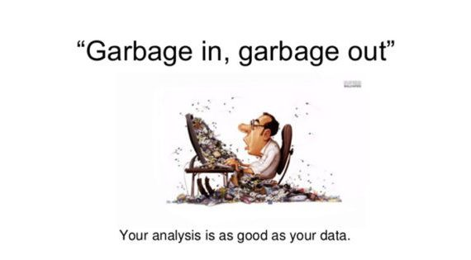
What is Input Validation & Output Encoding?
So you are inside, you fancy a beer and the barman hands you water from the toilet. Do you drink it?
Validating both what's coming in and going out has been an eternal struggle since the dawn of time. Get this wrong and all hell breaks loose.

Slide 123

Notable Hacks
Take your pick, there are so many!
The Philippines’ Commission on Elections breach, in which 77,736,795 records, representing the entire adult population of the Philippines (!) were stored in plaintext and easily obtained by a hacker via SQL injection.
Notes:
Pic is RFP or Jeff Forristal (Mr SQLi)

Slide 124
1.5.1 Input and output architecture
Verify that input and output requirements clearly define how to handle and process data based on type, content, and applicable laws, regulations, and other policy compliance.
Rationale
Differing mechanisms in different areas results in exploiting different interpreters
Orange Tsai’s SSRF research
Relevant standards
OWASP Top 10 A1, A4, A7
OWASP Proactive Controls C4 and C5
PCI DSS 6.5.1 and 6.5.7
NIST 800-53 SI-9 SI-10 SI-15
Recommended solutions
Input validation CX at entry
Input validation enforcement close to entry
Output encoding just prior to interpreter
Be strict with what you accept, and send
Architecture review
Sample a set of inputs
Validate that validation enforcement is near entry
Validate that output encoding occurs just prior to the relevant interpreter, with the correct context

Slide 125
1.5.2 Serialization architecture
Verify that serialization is not used when communicating with untrusted clients. If this is not possible, ensure that adequate integrity controls (and possibly encryption if sensitive data is sent) are enforced to prevent deserialization attacks including object injection.
Rationale
Remote code execution
Big payouts for bug bounties
There are easier ways
Relevant standards
OWASP Top 10 A1, A4, A7
OWASP Proactive Controls C4 and C5
PCI DSS 6.5.1 and 6.5.7
NIST 800-53 SI-9 SI-10 SI-15
Recommended solutions
Don’t send serialized objects to clients
If you have to send serialized objects, use a safer format, like JSON and a well known JSON library
Architecture Review
Review trust boundaries and determine if any serialized objects flow across them
What controls are in place to prevent deserialization attacks
Integrity controls (per JWT)
Confidentiality controls
Replay controls

Slide 126
1.5.3 Input validation architecture
Verify that input validation is enforced on a trusted service layer.
Rationale
Client side validation is trivially bypassed
All injections etc rely on this failure
Relevant standards
OWASP Top 10 A1, A4, A7
OWASP Proactive Controls C4 and C5
PCI DSS 6.5.1 and 6.5.7
NIST 800-53 SI-9 SI-10 SI-15
Recommended solutions
Implement a single conceptual view of input validation using known trusted validation libraries in trusted components
Implement client-side validation for CX only
Architecture review
Review trust boundaries where untrusted data is received, processed or stored by trusted components
Determine the input validation mechanisms in the trusted components to handle hostile data inputs

Slide 127
1.5.4 Output encoding architecture
Verify that output encoding occurs close to or by the interpreter for which it is intended.
Rationale
All injections are caused by the lack of output encoding or the use of safer parameterized queries or auto-encoded templaters
Relevant standards
OWASP Top 10 A1, A4, A7
OWASP Proactive Controls C4 and C5
PCI DSS 6.5.1 and 6.5.7
NIST 800-53 SI-9 SI-10 SI-15
Recommended solutions
Output encoding should occur as close to the interpreter as possible
Data must be output encoded for that interpreter (only)
Use safer mechanisms that escaping where possible (parameterized queries, ORMs, auto-escaping templaters, etc)
Architecture Review
Determine output encoding strategy
Sample database and web rendering sinks for output encoding
Missing, ineffective, effective?

Slide 128
5.1.1 Parameter Pollution Prevention
Verify that the application has defenses against HTTP parameter pollution attacks, particularly if the application framework makes no distinction about the source of request parameters (GET, POST, cookies, headers, or environment variables).
Rationale
Bypass input validation
Relevant standards
OWASP Top 10 A1, A4, A7
OWASP Proactive Controls C4 and C5
PCI DSS 6.5.1 and 6.5.7
NIST 800-53 SI-9 SI-10 SI-15
Recommended solutions
Be specific about where parameters should come from (GPCES)
Caution: PHP with $_REQUEST
Unit Tests
Not applicable
End to end integration tests
Should fail:
Submit a URL parameter and a body parameter with the same name
Submit a body value as a cookie
Submit a body value as a URL
Submit a cookie value in the URL
Submit a cookie value in the body
Submit a URL value in body
Submit a URL value in cookies

Slide 129
5.1.2 Mitigate mass parameter assignment
Verify that frameworks protect against mass parameter assignment attacks, or that the application has countermeasures to protect against unsafe parameter assignment, such as marking fields private or similar.
Rationale
Bypass field access controls
Bypass input validation
Bypass WAFs
Relevant standards
OWASP Top 10 A1, A4, A7
OWASP Proactive Controls C4 and C5
PCI DSS 6.5.1 and 6.5.7
NIST 800-53 SI-9 SI-10 SI-15
Recommended solutions
Use whitelisting bindable, non-sensitive fields.
Blacklist non-bindable, sensitive fields
Unit Tests
Use fuzzing of the parameter to detect changes
Fuzz the parameter value for different data types (integers, strings, etc.)
End to end integration tests
Include private fields in requests which use auto-binding
Fail if this takes effect in the application (such as promotion to admin, changed balance, or similar)

Slide 130
5.1.3 Positive validation preferred
Verify that all input (HTML form fields, REST requests, URL parameters, HTTP headers, cookies, batch files, RSS feeds, etc) is validated using positive validation (whitelisting).
Rationale
Positive validation is specific and fast
Negative validation assumes you know more about the data than an attacker
Relevant standards
OWASP Top 10 A1, A4, A7
OWASP Proactive Controls C4 and C5
PCI DSS 6.5.1 and 6.5.7
NIST 800-53 SI-9 SI-10 SI-15
Recommended solutions
Use positive validation where possible (i.e. not text fields)
In text fields, use length restrictions, positive character filtering, and negative validation
Unit Tests
Submit a wide range of input data, particularly from SecLists to text fields
Ensure that validations fail securely
End to end integration tests
Same as unit tests

Slide 131
5.1.4 Strongly type data (no, seriously)
Verify that structured data is strongly typed and validated against a defined schema including allowed characters, length and pattern (e.g. credit card numbers or telephone, or validating that two related fields are reasonable, such as checking that suburb and zip/postcode match).
Rationale
Most injections don’t work if you convert them to booleans, integers, or dates
Reduce defects before you go live
Relevant standards
OWASP Top 10 A1, A4, A7
OWASP Proactive Controls C4 and C5
PCI DSS 6.5.1 and 6.5.7
NIST 800-53 SI-9 SI-10 SI-15
Recommended solutions
Consider using typed languages (TypeScript instead of JavaScript, C# or Java, Go, etc)
Unit Tests
Send in a range of SecLists string payloads to functions that should be accepting non-strings
End to end integration tests
Same as Unit Tests

Slide 132
5.1.5 Static redirection and forwards
Verify that URL redirects and forwards only allow whitelisted destinations, or show a warning when redirecting to potentially untrusted content.
Rationale
Open Redirection was a part of the OWASP Top 10 for nearly 15 years
Bypasses many security checks
Makes attacks more believable
Relevant standards
OWASP Top 10
OWASP Proactive Controls
NIST 800-63
PCI DSS 6.5.x
NIST 800-53
Recommended solutions
Don’t send the URL to the client, ever.
Internally, have a static or protected URL destination
Unit Tests
Review code that might send a redirect or a 302 message
Inject hostile URLs into any parameters
Determine if the 302 contains the hostile parameter
End to end integration tests
For parameters that take URLs or routes as a destination, include hostile URL payloads
Determine if the response contains the hostile URL

Slide 133
5.2.1 Sanitize HTML and Markdown input
Verify that all untrusted HTML input from WYSIWYG editors or similar is properly sanitized with an HTML sanitizer library or framework feature.
Rationale
It’s not possible to completely determine the complete “safe” mark up of HTML or Markdown due to version and dialect changes
HTML 4.0 apps are often at risk when using HTML 5.0 browsers
Relevant standards
OWASP Top 10 A1, A4, A7
OWASP Proactive Controls C4 and C5
PCI DSS 6.5.1 and 6.5.7
NIST 800-53 SI-9 SI-10 SI-15
Recommended solutions
Use one of the more popular HTML sanitization or markdown libraries
Use auto-templaters to protect against XSS
Unit Tests
Inject hostile HTML (XSS locators)
Inject hostile markdown (XSS locators)
End to end integration tests
Inject hostile HTML (XSS locators)
Inject hostile markdown (XSS locators)

Slide 134
5.2.2 Enforce unstructured data restrictions
Verify that unstructured data is sanitized to enforce safety measures such as allowed characters and length.
Rationale
Unstructured data is particularly difficult to validate
Still a source of injections and XSS
Relevant standards
OWASP Top 10 A1, A4, A7
OWASP Proactive Controls C4 and C5
PCI DSS 6.5.1 and 6.5.7
NIST 800-53 SI-9 SI-10 SI-15
Recommended solutions
Enforce typing if possible
Restrict length
Restrict composition
Name variables and methods in such a way as to indicate dangerous source
Unit Tests
Test a wide variety of payloads to unstructured parameters
End to end integration tests
Test a wide variety of payloads to unstructured parameters

Slide 135
5.2.4 eval() is evil()
5.2.4 Verify that the application avoids the use of eval() or other dynamic code execution features. Where there is no alternative, any user input being included must be sanitized or sandboxed before being executed.
Rationale
Remote Code Execution
Object and state manipulation
Compromise of systems
Relevant standards
OWASP Top 10 A1, A4, A7
OWASP Proactive Controls C4 and C5
PCI DSS 6.5.1 and 6.5.7
NIST 800-53 SI-9 SI-10 SI-15
Recommended solutions
Eliminate eval()
Disable features that allow eval()
Don’t allow user input in eval()
Sandbox eval() execution with containers or similar (now you have two problems!)
Unit Tests
Test with eval and OS command payloads
End to end integration tests
Test with eval and OS command payloads

Slide 136
5.2.5 Protect against template injection
Verify that the application protects against template injection attacks by ensuring that any user input being included is sanitized or sandboxed.
Rationale
XSS injection
Expression language injection
Template language injection
Relevant standards
OWASP Top 10 A1, A4, A7
OWASP Proactive Controls C4 and C5
PCI DSS 6.5.1 and 6.5.7
NIST 800-53 SI-9 SI-10 SI-15
Recommended solutions
Use auto-escaping template frameworks
Unit Tests
Test with XSS and template injection payloads
Ensure the resulting HTML or DOM writes do not contain XSS
End to end integration tests
Test with XSS and template injection payloads
Ensure the resulting DOM does not contain active XSS

Slide 137
5.2.6 Protect against Server Side Request Forgery (SSRF)
Verify that the application protects against SSRF attacks, by validating or sanitizing untrusted data or HTTP file metadata, such as filenames and URL input fields, use whitelisting of protocols, domains, paths and ports.
Rationale
Most commonly attacked issue in cloud environments
SSRF is prevalent but underreported
Not well known amongst devs as not in Top 10
Attackers know how to exploit
Relevant standards
OWASP Top 10 A1, A4, A7
OWASP Proactive Controls C4 and C5
PCI DSS 6.5.1 and 6.5.7
NIST 800-53 SI-9 SI-10 SI-15
Recommended solutions
Avoid using user supplied filenames and URLs
Decompose and positively validate all portions of supplied filenames and URLs
Force containers and servers to communicate through a whitelist only proxy
Containers – block and monitor all (new) outbound communication
Unit Tests
Test with SSRF payloads against known canary
Fail if resulting (mock) connection might open a connection to the canary
End to end integration tests
Test with SSRF payloads with known canary filename or URL
Fail if the canary system receives any connections
If blocking all outbound connections on a container, check for attempted connections in logs
Notes:
Talk about cloud API metadata services here, such as the Capital One hack and how they need to understand the architecture they are using.

Slide 138
5.3.1 Contextually correct output encoding
Verify that output encoding is relevant for the interpreter and context required. For example, use encoders specifically for HTML values, HTML attributes, JavaScript, URL Parameters, HTTP headers, SMTP, and others as the context requires, especially from untrusted inputs including Unicode or apostrophes.
Rationale
Context is critical – SMTP is not HTML attributes
A-Za-z0-9 is unlikely to be acceptable in most parts of the world
Unicode has many spaces, many “I”s and so on
Relevant standards
OWASP Top 10 A1, A4, A7
OWASP Proactive Controls C4 and C5
PCI DSS 6.5.1 and 6.5.7
NIST 800-53 SI-9 SI-10 SI-15
Recommended solutions
Use an auto-escaping template that automatically performs contextual escaping
Or determine the output context of the interpreter in use, and find a library to perform that output encoding
Don’t double encode
Don’t store encoded
Unit Tests
Compose a template with XSS or template encoded XSS
Failed if active XSS is present in the HTML to be rendered
End to end integration tests
Use XSS or template encoded XSS payloads for parameters likely to be included in templates or on screen
Failed if active XSS is present in the resulting DOM

Slide 139
5.3.10 Prevent XPath and XML injection
Verify that the application protects against XPath injection or XML injection attacks.
Rationale
Disclose sensitive data from other users
XML node injection
XXE and other XML related attacks
External entities = SSRF
Relevant standards
OWASP Top 10 A1, A4, A7
OWASP Proactive Controls C4 and C5
PCI DSS 6.5.1 and 6.5.7
NIST 800-53 SI-9 SI-10 SI-15
Recommended solutions
Use modern XML libraries
Disable XML external entities
Use XML escaping mechanisms
Don’t hand construct Xpath or XML documents
Unit Tests
Fail if the result is not expected
Test a safe Xpath / XML / XSL payload
Test XML fuzz and XXE payloads from SecLists
End to end integration tests
Fail if the result is not expected
Test a safe Xpath payload
Test XML fuzz and XXE payloads from SecLists

Slide 140
5.3.3 Use auto-escaping templaters
Verify that context-aware, preferably automated - or at worst, manual - output escaping protects against reflected, stored, and DOM based XSS.
Rationale
Figuring out the context is hard
Code with manual escaping is difficult to read
Even one missed parameter will result in XSS
Relevant standards
OWASP Top 10 A1, A4, A7
OWASP Proactive Controls C4 and C5
PCI DSS 6.5.1 and 6.5.7
NIST 800-53 SI-9 SI-10 SI-15
Recommended solutions
Use auto-escaping template solutions
Angular – use context methods provided
React – only one single method
Handlebars, etc
Be wary of concatenating user supplied inputs to create templates
Unit Tests
For each source parameter used in output, test
expected values
SecLists XSS fuzzes
SecLists HTML 5 fuzzes
Fail if XSS is part of a resulting response
End to end integration tests
For each source parameter used in output, inject
expected values
SecLists XSS fuzzes
SecLists HTML 5 fuzzes
Fail if XSS results from this testing

Slide 141
5.3.4 Use safe data access frameworks
Verify that data selection or database queries (e.g. SQL, HQL, ORM, NoSQL) use parameterized queries, ORMs, entity frameworks, or are otherwise protected from database injection attacks.
Rationale
SQL injections used to be one of the most common methods of data breaches
Advanced exploitation tools make SQL injection accessible to even weak attackers
Impact is off the charts
Relevant standards
OWASP Top 10 A1, A4, A7
OWASP Proactive Controls C4 and C5
PCI DSS 6.5.1 and 6.5.7
NIST 800-53 SI-9 SI-10 SI-15
Recommended solutions
Use parameterized queries, ORMs, entity frameworks
Use SQL encoding if parameterized queries are not available
You can’t escape table names, column names, clauses, and SQL metadata
Unit Tests
Test models with SQL injection locators and fuzz lists
End to end integration tests
Where input data ends up in a query, inject SQL injection locators and fuzz lists

Slide 142
5.3.6 Prevent JavaScript and JSON injection
Verify that the application projects against JavaScript or JSON injection attacks, including for eval attacks, remote JavaScript includes, CSP bypasses, DOM XSS, and JavaScript expression evaluation.
Rationale
Most modern applications are now written using JavaScript
JavaScript and JSON have many ways of evaluating user supplied code
Not commonly tested today
Relevant standards
OWASP Top 10 A1, A4, A7
OWASP Proactive Controls C4 and C5
PCI DSS 6.5.1 and 6.5.7
NIST 800-53 SI-9 SI-10 SI-15
Recommended solutions
Use safer JSON libraries, like GSON
Input validation
Don’t use eval()
Auto-escaping expressions and output
Send a content security policy header
Unit Tests
Similar to XSS tests; include JSON fuzz lists
End to end integration tests
Similar to XSS tests; include JSON fuzz lists

Slide 143
5.3.7 Prevent LDAP injection
Verify that the application protects against LDAP Injection vulnerabilities, or that specific security controls to prevent LDAP Injection have been implemented.
Rationale
Bypass authentication
Not commonly tested (properly)
Rare attack
LDAP libraries rarely have LDAP encoders
Relevant standards
OWASP Top 10 A1, A4, A7
OWASP Proactive Controls C4 and C5
PCI DSS 6.5.1 and 6.5.7
NIST 800-53 SI-9 SI-10 SI-15
Recommended solutions
Sanitize and validate user supplied input prior to constructing LDAP queries
Check that the number of results matches expected values (i.e. a search for a user returns one result)
Use LinqtoAD if on .NET, which automatically escapes LDAP
Unit Tests
Test LDAP functionality with:
Good usernames + passwords - pass
Good usernames with no / bad passwords - fail
Inject LDAP fuzz lists into username and password fields – should not login
End to end integration tests
Test LDAP functionality with:
Good usernames + passwords - pass
Good usernames with no / bad passwords - fail
Inject LDAP fuzz lists into username and password fields – should not login

Slide 144
5.3.8 Prevent OS Command Injection
Verify that the application protects against OS command injection and that operating system calls use parameterized OS queries or use contextual command line output encoding.
Rationale
Remote code execution
Complete compromise of underlying host
Lateral movement
Relevant standards
OWASP Top 10 A1, A4, A7
OWASP Proactive Controls C4 and C5
PCI DSS 6.5.1 and 6.5.7
NIST 800-53 SI-9 SI-10 SI-15
Recommended solutions
Don’t use user supplied data with system()
Use parameterized OS command methods if user supplied data is required
With PHP, there is a multitude of ways to perform system() style code execution
Unit Tests
Inject fuzz lists into methods that call out to the system
UnixAttacksFuzzDB.txt
WindowsAttacksFuzzDB.txt
End to end integration tests
Set up a canary and adjust the fuzz list to address the canary (or use Burp Collaborator)
Inject OS command fuzz lists into parameters that are the original source for those parameters

Slide 145
5.3.9 Prevent file inclusion attacks
Verify that the application protects against Local File Inclusion (LFI) or Remote File Inclusion (RFI) attacks.
Rationale
Path traversal
Server side includes
LFI/RFI/SSRF
Data exfiltration
Relevant standards
OWASP Top 10 A1, A4, A7
OWASP Proactive Controls C4 and C5
PCI DSS 6.5.1 and 6.5.7
NIST 800-53 SI-9 SI-10 SI-15
Recommended solutions
Don’t use user supplied file metadata or names directly with files
Block or whitelist proxy new outbound connections from containers and servers
Unit Tests
For components that deal with the file system, fuzz input parameters with LFI / RFI / path traversal lists
End to end integration tests
For UI components that allow file uploads, fuzz LFI / RFI / path traversal
Try SSRF fuzzing with canaries

Slide 146
5.4.1 Prevent buffer overflows
Verify that the application uses memory-safe string, safer memory copy and pointer arithmetic to detect or prevent stack, buffer, or heap overflows.
Rationale
Buffer overflows allow arbitrary code execution on your servers or the victim’s system
One of the oldest forms of malicious code on the Internet (Morris Worm - 1988)
Alignment with PCI DSS
Relevant standards
OWASP Top 10 A1, A4, A7
OWASP Proactive Controls C4 and C5
PCI DSS 6.5.2
NIST 800-53 SI-9 SI-10 SI-15
Recommended solutions
Review use after free / JOP / ROP / stack / heap overflow techniques and JS sandbox escapes
Review “Writing Secure Code” to avoid known insecure memory allocation, heap, and so on
Use a safer language like Go, Rust, or Swift
Compile C / C++ / Objective C with stack cookies / guard / canary switches and pointer authentication (PAC) on iOS A12 platforms
Scan code with static code analysis tools to find potential buffer overflows
Unit Tests
Test with null pointers
Test with n-1, n, and n+1 words
Fuzz with over large data inputs
Integer overflows (wrap arounds) even work in Java
End to end integration tests
As per unit tests; emulate null pointers in many instances by not including the parameter

Slide 147
5.4.2 Use format strings carefully
Verify that format strings do not take potentially hostile input and are constant.
Rationale
Pathway to simple buffer overflows
Relevant standards
OWASP Top 10 A1, A4, A7
OWASP Proactive Controls C4 and C5
PCI DSS 6.5.2
NIST 800-53 SI-9 SI-10 SI-15
Recommended solutions
Review any use of printf, sprintf, snprintf etc
As per buffer overflows
Unit Tests
As per buffer overflows
End to end integration tests
As per buffer overflows

Slide 148
5.4.3 Validate numbers for sign and range
Verify that sign, range, and input validation techniques are used to prevent integer overflows.
Rationale
Quantities in business logic
Java integer overflow (no unsigned)
JavaScript sandbox escapes
Relevant standards
OWASP Top 10 A1, A4, A7
OWASP Proactive Controls C4 and C5
PCI DSS 6.5.1 and 6.5.7
NIST 800-53 SI-9 SI-10 SI-15
Recommended solutions
Validate for sign (especially unsigned)
-0 is a thing
Natural numbers for quantities
Unit Tests
Test for –n, -1, -0, 0, 1, n (where n is huge)
End to end integration tests
Test for –n, -1, -0, 0, 1, n (where n is huge)

Slide 149
5.5.2 Protect against XXE (and SSRF)
Verify that the application correctly restricts XML parsers to only use the most restrictive configuration possible and to ensure that unsafe features such as resolving external entities are disabled to prevent XXE.
Rationale
One of the most commonly exploited issues in cloud environments today
High payouts in bug bounties
Can result in remote code execution (RCE)
Relevant standards
OWASP Top 10 A1, A4, A7
OWASP Proactive Controls C4 and C5
PCI DSS 6.5.1 and 6.5.7
NIST 800-53 SI-9 SI-10 SI-15
Recommended solutions
Disable XML External Entities
Upgrade XML processors
Block new outbound connections from servers or only via a whitelisted proxy server
Monitor outbound connection attempts
Unit Tests
Use XXE fuzz list
End to end integration tests
Use XXE fuzz list

Slide 150
Input validation labs
Please complete your previous day labs
Input validation (<language>)
Secure Code Warrior A1
Secure Code Warrior A7
We will resume at 9.45 am

Slide 151
End of Day 1
Day 2 starts at 9 am sharp!

Slide 152
Securing Applications with OWASP Application Security Verification Standard 4.0
Day 2

Slide 153
What did we learn yesterday?
Morning
Afternoon
About ASVS
Incorporating ASVS into your development lifecycle
V1 Architecture
V2 Authentication
V3 Session Management
V4 Access Control
V5 Validation and Encoding

Slide 154
Agenda Day 2
Morning
Afternoon
V5 Validation and Encoding Lab (cont)
V6 Cryptography at rest
V6 Cryptography Lab
V7 Logging and Error Handling
V8 Logging lab
V8 Data Protection
V8 Data Protection Lab
V9 Communications Security
V9 Communications Security Lab
V10 Malicious Code
V10 Malicious Code Lab

Slide 155

Cryptography at rest

Slide 156

What is Cryptography at Rest?
The club is pumping, and someone just handed you a secret code to get into the VIP room. But it's all garbled.
Good cryptography ensures peeping toms can't see what they shouldn't see.

Slide 157
Notable Hacks
Notes:
Pic is RFP or Jeff Forristal (Mr SQLi)

Slide 158
1.6.1 Secure Key Management Processes
Verify that there is an explicit policy for management of cryptographic keys and that a cryptographic key lifecycle follows a key management standard such as NIST SP 800-57.
Rationale
Static never changing keys become ever more difficult to change
Dynamic keys are still difficult to manage and change (certificates anyone?)
The lack of a defined key management process leads to expired keys and certificates, outages
Easy decryption due to the use of old keys and algorithms
Relevant standards
OWASP Top 10 A3
OWASP Proactive Controls C8
PCI DSS 6.5.3
NIST 800-53 SC-13 SC-28
Recommended solutions
Adopt a key management policy such as NIST 800-57
Ensure your application is compliant with it
Architecture Review
Review key management documentation and processes
Sample some of the keys to see if they have been managed in accordance with the policy

Slide 159
1.6.2 Store keys securely
Verify that consumers of cryptographic services protect key material and other secrets by using key vaults or API based alternatives.
Rationale
Attackers who have local access will also then have access to all your data
Relevant standards
OWASP Top 10 A3
OWASP Proactive Controls C8
PCI DSS 6.5.3
NIST 800-53 SC-13 SC-28
Recommended solutions
Use the OS supplied key store
Use a cloud key store
Use a HSM
Architecture Review
Review how and where keys are stored
Keys should be stored in a key vault
Keys should not be on the disk or in configuration files
If keys are stored in the main database, there should be some level of key unlocking rather than direct use
Consider multi-tenant issues – key per client, etc

Slide 160
1.6.3 Replaceable keys
Verify that all keys and passwords are replaceable and are part of a well-defined process to re-encrypt sensitive data.
Rationale
Static keys become a liability
During breaches you have to change them immediately
Not knowing the impacts of change creates a risk to business recovery
Relevant standards
OWASP Top 10 A3
OWASP Proactive Controls C8
PCI DSS 6.5.3
NIST 800-53 SC-13 SC-28
Recommended solutions
Document key replacement mechanism
Include functionality to remind administrators to create, update, manage, and revoke keys
If keys are used to encrypt data
Method to create or accept new key
Method to re-encrypt data in a timely fashion
Architecture Review
Ensure keys used within the application can be revoked and replaced
Ensure that data encrypted with a previous key can be re-encrypted
Multi-tenant consideration of a key per client

Slide 161
6.1.1 Encrypt regulated data at rest
Verify that regulated private data is stored encrypted while at rest, such as personally identifiable information (PII), sensitive personal information, or data assessed likely to be subject to EU's GDPR.
Rationale
Required by PCI DSS, HIPPA, GDPR
Prevents data breaches using offline storage, SQL dumps, backups from releasing any information
Relevant standards
OWASP Top 10 A3
OWASP Proactive Controls C8
PCI DSS 6.5.3
NIST 800-53 SC-13 SC-28
Recommended solutions
Review local regulations to determine what you must (or more likely - should) encrypt
Encrypt at least personal health information
Remove data as soon as its no longer needed
Unit Tests
Create a record containing test regulated data
Persist the record
Retrieve the record directly from the data layer. It should not be plain text
End to end integration tests
Not applicable

Slide 162
6.1.2 Encrypt health data
Verify that regulated health data is stored encrypted while at rest, such as medical records, medical device details, or de-anonymized research records.
Rationale
Some of the most sensitive data held
Breaches often lead to negative outcomes for patients and huge fines
Relevant standards
HIPPA Security Rule covers PHI, but does not mandate encryption
GDPR – covers PHI, but does not mandate encryption but talks about it extensively
OWASP Top 10 A3
OWASP Proactive Controls C8
PCI DSS 6.5.3
NIST 800-53 SC-13 SC-28
Recommended solutions
Review local regulations to determine what you must encrypt
Encrypt at least personal health information
Remove data as soon as its no longer needed
Unit Tests
Create a record containing test regulated data
Persist the record
Retrieve the record directly from the data layer. It should not be plain text
End to end integration tests
Not applicable

Slide 163
6.2.1 Fail securely
Verify that all cryptographic modules fail securely, and errors are handled in a way that does not enable Padding Oracle attacks.
Rationale
Exceptions and errors should not result in decryption or plain text
Relevant standards
OWASP Top 10 A3
OWASP Proactive Controls C8
PCI DSS 6.5.3
NIST 800-53 SC-13 SC-28
Recommended solutions
If an exception or error is raised, securely free any partially or fully decrypted data
Unit Tests
Create a test record
Retrieve the record and try to decrypt it
Force an error
Show that error handling clears the plain text of the secure record
End to end integration tests
Not applicable

Slide 164
6.2.2 Use secure, approved algorithms
Verify that industry proven or government approved cryptographic algorithms, modes, and libraries are used, instead of custom coded cryptography. C8
Rationale
Old algorithms are either completely broken (RC4, DES, 3DES, MD5, SHA1) or close to it (SHA256, etc)
FPGA and GPU crackers
Relevant standards
OWASP Top 10 A3
OWASP Proactive Controls C8
PCI DSS 6.5.3
NIST 800-53 SC-13 SC-28
Recommended solutions
Implement cryptographic agility (see slides coming up)
Review existing cryptography algorithms and modes
Migrate from old, broken to new algorithms that will last for 5+ years
Unit Tests
In unit tests testing crypto using old or deprecated algorithms, the unit test should fail to help weed out that code
End to end integration tests
Not applicable

Slide 165
6.2.3 Use secure advice for crypto defaults
Verify that encryption initialization vector, cipher configuration, and block modes are configured securely using the latest advice.
6.2.5 Verify that known insecure block modes (i.e. ECB, etc.), padding modes (i.e. PKCS#1 v1.5, etc.), ciphers with small block sizes (i.e. Triple-DES, Blowfish, etc.), and weak hashing algorithms (i.e. MD5, SHA1, etc.) are not used unless required for backwards compatibility.
Rationale
Advice on cryptographic algorithms, modes, and hashes rapidly changes
Old advice is likely completely out of date
Most infosec professionals don’t keep up with current standards
Relevant standards
OWASP Top 10 A3
OWASP Proactive Controls C8
PCI DSS 6.5.3
NIST 800-53 SC-13 SC-28
Recommended solutions
Review your crypto framework’s documentation for the latest advice
Search if this is still solid advice (hint: it’s usually not)
Ask for help from professional cryptographers if in doubt
Unit Tests
Same as 6.2.2
End to end integration tests
Not applicable

Slide 166
6.2.4 Cryptographic agility
Verify that random number, encryption or hashing algorithms, key lengths, rounds, ciphers or modes, can be reconfigured, upgraded, or swapped at any time, to protect against cryptographic breaks.
Rationale
Cryptographic breaks improves over time, algorithms don’t
Relevant standards
OWASP Top 10 A3
OWASP Proactive Controls C8
PCI DSS 6.5.3
NIST 800-53 SC-13 SC-28
Recommended solutions
Implement cryptographic agility
Plan for re-encrypting / re-hashing all encrypted data
Unit Tests
Change keys or algorithms
Re-encrypt data
Ensure that Plaintext B is the same as Plaintext A
End to end integration tests
Should be behind the scenes

Slide 167
6.2.6 Secure initiatialization vectors
Verify that nonces, initialization vectors, and other single use numbers must not be used more than once with a given encryption key. The method of generation must be appropriate for the algorithm being used.
Rationale
Debian SSH breach
Static IVs (i.e. array of nulls are predictable)
Relevant standards
OWASP Top 10 A3
OWASP Proactive Controls C8
PCI DSS 6.5.3
NIST 800-53 SC-13 SC-28
Recommended solutions
Review crypto framework on choosing a solid IV. Usually it’s just a random number
Generate a secure random bag of bytes
Secure the IV in configuration or in a HSM
Don’t commit IV’s to code
Unit Tests
Retrieve the IV
Encrypt a known value
Decrypt the result with the IV
Ensure the known value and plain text are the same
End to end integration tests
Not applicable

Slide 168
6.3.1 Use a secure random number generator
Verify that all random numbers, random file names, random GUIDs, and random strings are generated using the cryptographic module's approved cryptographically secure random number generator when these random values are intended to be not guessable by an attacker.
Rationale
Many random implementations are not particularly random (just fast)
Often, seeding is deterministic or static
Attackers might be able to generate the same seed and replicate the result (such as initial and password reset emails)
Relevant standards
OWASP Top 10 A3
OWASP Proactive Controls C8
PCI DSS 6.5.3
NIST 800-53 SC-13 SC-28
Recommended solutions
Use SecureRandom or the equivalent on your platform
Seed it with as many sources of entropy as you can muster (some processors have instructions, such as RDRAND, that can help)
TPM 1.2 chips can assist with obtaining seed values
Secure PRNGs will run a system out of entropy if overused, and some block until entropy returns
Unit Tests
Generate 10,000 random numbers
Check the entropy (randomness) to determine if the random values are sufficiently random
End to end integration tests
Not applicable (could potentially obtain a similar number of values and try to recover the seed, but this is difficult and not easily replicable in an automated test)

Slide 169
6.3.2 Generate GUIDs and UUIDs securely
Verify that random GUIDs are created using the GUID v4 algorithm, and a cryptographically-secure pseudo-random number generator (CSPRNG). GUIDs created using other pseudo-random number generators may be predictable.
Rationale
GUIDs are only guaranteed to be system unique – attackers might be able to generate new same GUIDs on a different system
Relevant standards
OWASP Top 10 A3
OWASP Proactive Controls C8
PCI DSS 6.5.3
NIST 800-53 SC-13 SC-28
Recommended solutions
Review crypto library implementation of GUID / UUID implementation
If there are fast or secure alternatives, use the secure version
Unit Tests
Generate 1,000 random GUIDs / UUIDs
Check the entropy (randomness) to determine if the random values are sufficiently random
End to end integration tests
Not applicable

Slide 170
6.4.1 Secure secrets management
Verify that a secrets management solution such as a key vault is used to securely create, store, control access to and destroy secrets.
Rationale
Storing keys in code or apps
Storing keys in plaintext in config files
Static keys in every installation
Relevant standards
OWASP Top 10 A3
OWASP Proactive Controls C8
PCI DSS 6.5.3
NIST 800-53 SC-13 SC-28
Recommended solutions
Use the operating system key store or a HSM is in use
Store secrets and keys in a secure key store
JKS bootstrapped using a secure OS key store or HSM is acceptable
Unit Tests
Not applicable
End to end integration tests
Not applicable

Slide 171
V6 Stored Crypto Lab

Slide 172
Error handling and logging

Slide 173
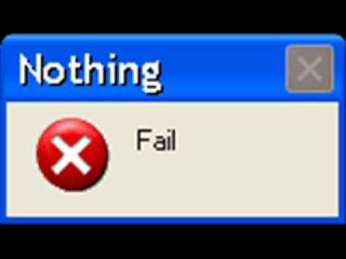
What is Error Handling and Logging?
You've just bumped into someone and spilt your drink on them and blurted out your bank account details by mistake. In the confusion, you didn't write their number down correctly to clean their clothes.
Errors should be helpful but not too helpful.

Slide 174
1.7.1 Common logging format
Verify that a common logging format and approach is used across the system.
Rationale
Permit faster response time to events, triage and escalation
Allow non-security systems such as Splunk or ELK to assist with monitoring and escalation
Relevant standards
OWASP Top 10 A10
OWASP Proactive Controls C9
PCI DSS 6.5.5
NIST 800-53 AU-12
Recommended solutions
Use a common logging format
Unit Tests
Not applicable
End to end integration tests
Not applicable

Slide 175
1.7.2 Secure log analysis and storage
Verify that logs are securely transmitted to a preferably remote system for analysis, detection, alerting, and escalation.
Rationale
Altering or deleting logs to cover tracks is a common attacker tactic
Relevant standards
OWASP Top 10 A10
OWASP Proactive Controls C9
PCI DSS 6.5.5
NIST 800-53 AU-6
Recommended solutions
Allow log shipping to other systems
Log to secured logs outside of the webroot, owned by different users
Unit Tests
Not applicable
End to end integration tests
Not applicable

Slide 176
7.1.1 Don’t log sensitive stuff
Verify that the application does not log credentials or payment details. Session tokens should only be stored in logs in an irreversible, hashed form.
Rationale
Logs become highest value data assets
Relevant standards
OWASP Top 10 A10
OWASP Proactive Controls C9
PCI DSS 6.5.5
NIST 800-53 AU-3
Recommended solutions
Log masked values or truncated values if you must
Log these only in debug mode
Prod builds shouldn’t be able to use debug mode
Unit Tests
Create log events such as during authentication or failed access control
Test logs do not contain test user password, session ID, or any sensitive info
End to end integration tests
Not applicable

Slide 177
7.1.2 Don’t log PII
Verify that the application does not log other sensitive data as defined under local privacy laws or relevant security policy.
Rationale
Hard “No” from privacy regulations
Relevant standards
OWASP Top 10 A3 A10
OWASP Proactive Controls C9
PCI DSS 6.5.5
NIST 800-53 AU-3
Recommended solutions
Don’t log PII
At worst, mask or truncate
Unit Tests
Create, alter or delete records that might contain PII
Review logs to ensure PII is not logged
End to end integration tests
Create, alter or delete records that contain PII

Slide 178
7.1.3 Log security relevant events
Verify that the application logs security relevant events including successful and failed authentication events, access control failures, deserialization failures and input validation failures.
Rationale
Attackers rely and love systems that don’t log or audit anything
Relevant standards
OWASP Top 10 A10
OWASP Proactive Controls C9
PCI DSS 6.5.5
NIST 800-53 AU-2
Recommended solutions
Log authentication, access control, high value business logic and other relevant events to allow reconstruction of attacker’s activities
Unit Tests
Generate security relevant errors
Check logs contain sufficient logging
Check logs don’t contain PII
End to end integration tests
Generate security relevant activities

Slide 179
7.1.4 Timeline reconstructcion
Verify that each log event includes necessary information that would allow for a detailed investigation of the timeline when an event happens.
Rationale
Attackers who cross multiple channels / streams rely on the lack of timeline reconstruction
Breach detection relies on timeline reconstruction to determine other compromised systems
Relevant standards
OWASP Top 10 A10
OWASP Proactive Controls C9
PCI DSS 6.5.5
NIST 800-53 AU-6 AU-7
Recommended solutions
Log events with sufficient information and accurate time stamps
Unit Tests
Create errors
Ensure logs contain sufficient information and accurate timestamps
End to end integration tests
Create errors

Slide 180
7.2.1 Log authentication events
Verify that all authentication decisions are logged, without storing sensitive session identifiers or passwords. This should include requests with relevant metadata needed for security investigations.
Rationale
Allows detection of brute force, credential stuffing, and other attacks
Relevant standards
OWASP Top 10 A10
OWASP Proactive Controls C9
PCI DSS 6.5.5
NIST 800-53 AU-4
Recommended solutions
Always log failed logins
Log successful logins per admin requirement
Unit Tests
Test logging of failed logins
Test optional logging of granted logins
End to end integration tests
Test failed logins
Test permitted logins
Review logs to ensure that log events were generated

Slide 181
7.2.2 Log access control decisions
Verify that all access control decisions can be logged and all failed decisions are logged. This should include requests with relevant metadata needed for security investigations.
Rationale
Allow detection of horizontal and vertical privilege escalation attacks
Relevant standards
OWASP Top 10 A10
OWASP Proactive Controls C9
PCI DSS 6.5.5
NIST 800-53 AU-4
Recommended solutions
Log failed access control decisions always
Log permitted access control decisions based upon admin config
Unit Tests
Test failed access – was log created?
Test granted access – was log created if logging enabled?
End to end integration tests
Generate failed and granted access control decisions

Slide 182
7.3.2 Prevent log injection
Verify that all events are protected from injection when viewed in log viewing software.
Rationale
Log injection – HTML attacks
Log injection – integrity attacks
Log injection – non-repudiation attacks
Relevant standards
OWASP Top 10 A10
OWASP Proactive Controls C9
PCI DSS 6.5.5
NIST 800-53 AU-4
Recommended solutions
Escape any user supplied input
Don’t use HTML in logs unless required
Unit Tests
Not applicable
End to end integration tests
Not applicable

Slide 183
7.3.3 Protect security logs and systems
Verify that security logs are protected from unauthorized access and modification.
Rationale
Don’t let attackers wipe or alter history
Allows reliable monitoring, triage and escalation
Allows prosecutions to proceed
Relevant standards
OWASP Top 10 A10
OWASP Proactive Controls C9
PCI DSS 6.5.5
NIST 800-53 AU-9
Recommended solutions
Log ship where possible
Log to the system logs where the application framework can’t alter the logs
Unit Tests
Try to alter or delete log files
End to end integration tests
Not applicable

Slide 184
7.3.4 Synchronized clocks
Verify that time sources are synchronized to the correct time and time zone. Strongly consider logging only in UTC if systems are global to assist with post-incident forensic analysis.
Rationale
Timeline reconstruction is impossible without this
Pretty much standard today
Relevant standards
OWASP Top 10 A10
OWASP Proactive Controls C9
PCI DSS 6.5.5
NIST 800-53 AU-8
Recommended solutions
Make life simple. Use UTC for servers
Run NTP (default for ~100% of OSs today)
Unit Tests
Not applicable
End to end integration tests
Not applicable

Slide 185
7.4.1 User actionable error messages
Verify that a generic message is shown when an unexpected or security sensitive error occurs, potentially with a unique ID which support personnel can use to investigate.
Rationale
Most users can’t fix your code
Attackers love detailed errors and exceptions
Older platforms exposed a lot of info
Debug consoles are a thing
Relevant standards
OWASP Top 10 A10
OWASP Proactive Controls C10
PCI DSS 6.5.5
NIST 800-53 AU-4
Recommended solutions
Implement custom error messages
Log dev ready content to logs
Gather consent, and fire them at Jira or GitHub Issues or something commercial like a diagnostics services
Unit Tests
Ensure that detailed errors do not contain sensitive info
Send them off to some form of analysis service if consent is granted
End to end integration tests
Force errors or similar to trigger logs to analysis services
Errors should not be detailed
Errors should be actionable by the user

Slide 186
7.4.2 Do exceptions or error handling
Verify that exception handling (or a functional equivalent) is used across the codebase to account for expected and unexpected error conditions.
Rationale
Not doing it allows attackers a free pass
Exceptions required for Java, others
Errors for Go, others
Relevant standards
OWASP Top 10 A10
OWASP Proactive Controls C10
PCI DSS 6.5.5
NIST 800-53 AU-4
Recommended solutions
Choose one way or the other
Be consistent in your handling
Unit Tests
Trigger errors as often as possible
End to end integration tests
Trigger errors as often as possible

Slide 187
7.4.3 Last resort error handler
Verify that a "last resort" error handler is defined which will catch all unhandled exceptions.
Rationale
Sometimes panic() is an ok response
Other times, “turn it off and on again”
Relevant standards
OWASP Top 10 A10
OWASP Proactive Controls C10
PCI DSS 6.5.5
NIST 800-53 AU-4
Recommended solutions
Have a high level handler for things you won’t handle, like out of memory or no more threads
Decide on a tactic to deal with this
Kill the container
Restart the app
Regularly reboot
Unit Tests
Not applicable
End to end integration tests
Not applicable

Slide 188
Error Handling and Logging Lab
Secure Code Warrior

Slide 189
Data protection

Slide 190

What is Data Protection?
Writing your home address and phone number on the toilet wall might not the best idea you've had.
Data protection is about ensuring sensitive data is stored and handled in a secure way

Slide 191

Notable Hacks
So many buckets...
The U.S. defense contractor left data publicly accessible through an insecurely configured S3 account containing files related to the National Geospatial-Intelligence Agency (NGA), which handles battlefield satellite and drone imagery
Notes:
Pic is RFP or Jeff Forristal (Mr SQLi)

Slide 192
8.1.1 Sensitive data caching
Verify the application protects sensitive data from being cached in server components such as load balancers and application caches.
Rationale
Server components such as load balancers, CDNs and so on become valuable targets
Likely you do not have visibility of breaches at this layer
Relevant standards
OWASP Top 10 A3
OWASP Proactive Controls C8
PCI DSS 6.5.3 (if related to crypto)
NIST 800-53 SC-28
Recommended solutions
Design the application that treats front end caching and other systems as the public Internet
Use TLS between these components
Design URLs and APIs in a way that limits data caching in logs and server(less) state
Establish configuration that limits retention and storage
Architectural Review
Review the design of CDNs, front end accelerators, web farms, server-less functions, and so on
Determine if those components log or cache data
Determine any retention periods or if it can be disabled

Slide 193
8.1.2 Purge cached copies
Verify that all cached or temporary copies of sensitive data stored on the server are protected from unauthorized access or purged/invalidated after the authorized user accesses the sensitive data.
Rationale
Caches are rarely monitored
Often have high value / recent items
LRU purges might be too infrequent
Relevant standards
OWASP Top 10 A3
OWASP Proactive Controls C8
PCI DSS 6.5.3 (if related to crypto)
NIST 800-53 SC-28
Recommended solutions
Caches are awesome, but have a method to eliminate cached copies for sensitive data, such as immediately after logout or idle timeouts
Unit Tests
Test caching mechanism purges sensitive data
End to end integration tests
Not applicable

Slide 194
8.1.3 Minimize request data
Verify the application minimizes the number of parameters in a request, such as hidden fields, Ajax variables, cookies and header values.
Rationale
The browser is not a safe place for state
More parameters requires more input validation
It’s difficult to functionally test hidden values without Selenium / specialist tools
Attackers only need a single missed or ineffective validation
Relevant standards
OWASP Top 10 A3
OWASP Proactive Controls C8
PCI DSS 6.5.3 (if related to crypto)
NIST 800-53 SC-28
Recommended solutions
Review design choices where requests have more than approximately 20 or so parameters
Parameters users can’t see or change and are unused on the front end shouldn’t be on the client
Unit Tests
In routers and controllers, warn if the number of parameters is large
Ensure any large request is fully and extensively validated, concentrating on hidden / unchangeable values
End to end integration tests
Ensure that parameters that users cannot see or change are fully tested
Work with security folks to determine additional integration fuzz tests that make sense for parameters that cannot be easily functionally tested

Slide 195
8.1.4 Alert on high numbers of requests
Verify the application can detect and alert on abnormal numbers of requests, such as by IP, user, total per hour or day, or whatever makes sense for the application.
Rationale
Breaches and exfil requires mass record access
Relevant standards
OWASP Top 10 A3
OWASP Proactive Controls C8
PCI DSS 6.5.3 (if related to crypto)
NIST 800-53 SC-28
Recommended solutions
Keep tabs on relevant accesses
Alert above certain thresholds
Review OWASP Automation for guidance
Unit Tests
Test high value transactions for aggregate alerting
Attempt to use extensively
Attempt to use quickly
Mock multiple source IP addresses Mock multiple source IP addresses
Attempt to access others’ data
End to end integration tests
Access 10,000 records or try to register hundreds of accounts
Ensure that alerts have been issued

Slide 196
8.2.1 Anti-caching headers
Verify the application sets sufficient anti-caching headers so that sensitive data is not cached in modern browsers.
Rationale
Shared browsers
Browser extensions (to some degree)
Relevant standards
OWASP Top 10 A3
OWASP Proactive Controls C8
PCI DSS 6.5.3 (if related to crypto)
NIST 800-53 SC-28
Recommended solutions
Configure the app server to issue anti-caching headers for responses with sensitive data
Unit Tests
If manually constructing headers, test that response headers contain
End to end integration tests
Check that the response header contains appropriate anti-caching headers for sensitive data
Images and assets shared by all users, JS, etc can be cached if desired

Slide 197
8.2.2 Protect stored client-side sensitive data
Verify that data stored in client-side storage (such as HTML5 local storage, session storage, IndexedDB, regular cookies or Flash cookies) does not contain sensitive data or PII.
Rationale
Local Storage is just another database
Easily hacked by a local attacker
Typically a SQL Lite database
Relevant standards
OWASP Top 10 A3
OWASP Proactive Controls C8
PCI DSS 6.5.3 (if related to crypto)
NIST 800-53 SC-28
Recommended solutions
Minimize stored client-side sensitive data
Consider using encryption to make it slightly more difficult to view
Turtles all the way down
Unit Tests
Not applicable
End to end integration tests
Create a sensitive record that will end up in local client storage
Retrieve it directly
Plaintext – fail
If it needs protection, does it belong?

Slide 198
8.2.3 Clear client-side data upon logout
Verify that authenticated data is cleared from client storage, such as the browser DOM, after the client or session is terminated.
Rationale
Shared browsers
Browser extensions Browser extensions
Relevant standards
OWASP Top 10 A3
OWASP Proactive Controls C8
PCI DSS 6.5.3 (if related to crypto)
NIST 800-53 SC-28
Recommended solutions
Web Sockets – push deletion during logout
Idle timeouts on client side – delete sensitive data, invoke server side logout
Unit Tests
Not applicable
End to end integration tests
Idle out – should be no more sensitive data locally
Logout out – should be no more sensitive data locally

Slide 199
8.3.1 Send sensitive data in request body
Verify that sensitive data is sent to the server in the HTTP message body or headers, and that query string parameters from any HTTP verb do not contain sensitive data.
Rationale
Data in GET requests can be found in browser history and logs outside of your system
Relevant standards
OWASP Top 10 A3
OWASP Proactive Controls C8
PCI DSS 6.5.3 (if related to crypto)
NIST 800-53 SC-28
Recommended solutions
Credentials, PII, credit cards PANs, or other sensitive information in URL parameters or headers should be sent in the HTTP body, not in the URL or headers
Unit Tests
Review any API that requires sensitive data in the URL
Fail the test
Remove the API method / URL route
End to end integration tests
Per the unit tests

Slide 200
8.3.2 Rights to be forgotten and data takeout
Verify that users have a method to remove or export their data on demand.
Rationale
Required by GDPR
If you have any users in the EU, you are also subject to the GDPR
Users now expect these features
Relevant standards
OWASP Top 10 A3
OWASP Proactive Controls C8
PCI DSS 6.5.3 (if related to crypto)
NIST 800-53 SC-28
Recommended solutions
Provide a data take out feature
Provide a “right to be forgotten” feature that fully removes all data
Ensure that data take out and account deletion is heavily protected to prevent unauthorized disclosure or data destruction
Unit Tests
Test data takeout
As the current user
Attempt to download someone else’s takeout
Test data deletion
As the current test user – all data should be removed including the account.
As another user – should not be possible
End to end integration tests
Per unit tests

Slide 201
8.3.3 Data collection and privacy policies
Verify that users are provided clear language regarding collection and use of supplied personal information and that users have provided opt-in consent for the use of that data before it is used in any way.
Rationale
Firms that are unaware of privacy regulations are likely to suffer breaches
Most privacy regulations require linked privacy policies, and for apps to actually implement
Relevant standards
OWASP Top 10 A3
OWASP Proactive Controls C8
PCI DSS 6.5.3 (if related to crypto)
NIST 800-53 SC-28
Recommended solutions
Consider Australian Privacy Principles 11 – technical controls
Choose a privacy standard that meets or exceeds your local regulations
Implement the requirements from this privacy standard
Conduct a privacy impact analysis
Architecture Review
Review privacy policies in light of local privacy regulations
Consider if the app is likely to have users subject to GDPR
Consider if the policies and procedures are implemented by the application

Slide 202
8.3.5 Audit sensitive data access
Verify accessing sensitive data is audited (without logging the sensitive data itself), if the data is collected under relevant data protection directives or where logging of access is required.
Rationale
Breach monitoring is not possible without audit trails
Relevant standards
OWASP Top 10 A3
OWASP Proactive Controls C8
PCI DSS 6.5.3 (if related to crypto)
NIST 800-53 SC-28
Recommended solutions
Accessing high value records should be recorded
High value (and preferably all) transactions should be auditable
Ensure audit records don’t contain sensitive elements
Unit Tests
Perform high value transaction. An audit record should be created
Access high value data. An audit record should be created
End to end integration tests
Perform a high value transaction, change the user’s state, and access sensitive information Perform a high value transaction, change the user’s state, and access sensitive information
Review audit records Review audit records

Slide 203
8.3.6 Overwrite sensitive data memory
Verify that sensitive information contained in memory is overwritten as soon as it is no longer required to mitigate memory dumping attacks, using zeroes or random data.
Rationale
Mimikatz and metasploit
Relevant standards
OWASP Top 10 A3
OWASP Proactive Controls C8
PCI DSS 6.5.3 (if related to crypto)
NIST 800-53 SC-28
Recommended solutions
Use byte arrays in languages without secure string support
Zero out byte arrays and then free them
Unit Tests
Dump process memory after a sensitive record is freed
Determine if the sensitive data is within the memory dump
End to end integration tests
Not applicable

Slide 204
8.3.7 Encrypt sensitive data
Verify that sensitive or private information that is required to be encrypted, is encrypted using approved algorithms that provide both confidentiality and integrity.
Rationale
Data breaches are a thing
Protects against db dumps and backup exfil
Don’t make life easy for attackers
Relevant standards
OWASP Top 10 A3
OWASP Proactive Controls C8
PCI DSS 6.5.3 (if related to crypto)
NIST 800-53 SC-28
Recommended solutions
Ensure PII/PHI/regulated data is encrypted
Unit Tests
Create a sensitive record
Retrieve it
Should not be plaintext
End to end integration tests
Not applicable

Slide 205
8.3.8 Implement data retention (deletion) policy
Verify that sensitive personal information is subject to data retention classification, such that old or out of date data is deleted automatically, on a schedule, or as the situation requires.
Rationale
Stale data is useless
Stale data is a negative data asset with costs and no benefits
Some data, such as bank client info is collected at opening, and may need to exist for 100+ years
Be aware of data retention deleting such data
Relevant standards
OWASP Top 10 A3
OWASP Proactive Controls C8
PCI DSS 6.5.3 (if related to crypto)
NIST 800-53 SC-28
Recommended solutions
Implement age limits for all sensitive data
If the business requires sensitive data to be kept longer than the retention period, allow clients to renew your relationship with you or build in additional protection If the business requires sensitive data to be kept longer than the retention period, allow clients to renew your relationship with you or build in additional protection
Allow users to do a data takeout and the right to be forgotten
Unit Tests
Test in date data
Test data takeout
Should contain all current records
Test data retention (deletion)
Test right to be forgotten
End to end integration tests
Create sensitive data
Age it sufficiently to be subject to data retention
Determine if the application expires and clears out this “aged” data

Slide 206
Data Protection Lab

Slide 207
V9 Communications security

Slide 208

What is Communications Security?
Secure communications provides
Confidentiality
Integrity
Makes it harder for an attacker
Sniff / disclose sensitive traffic
Fabricate high value transactions
This Photo by Unknown Author is licensed under CC BY-NC

Slide 209
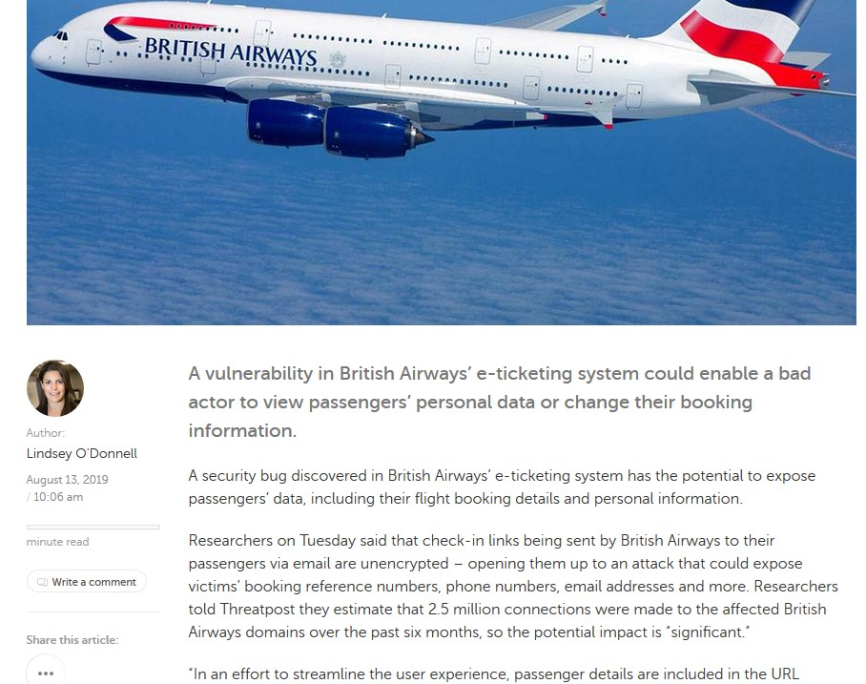
Some past breaches
Google data center backbones
Zero Trust
British Airways
Unencrypted links expose PII

Slide 210
9.1.1 Only expose encrypted end points
Verify that secured TLS is used for all client connectivity and does not fall back to insecure or unencrypted protocols.
Rationale
Unencrypted end points can result in sensitive information disclosure
Relevant standards
OWASP Top 10 A3
OWASP Proactive Controls C8
PCI DSS 6.5.4
NIST 800-53 SC-8
Recommended solutions
Only configure encrypted end points
Set up redirection or preferably disable unencrypted end points
Unit Tests
Not applicable
End to end integration tests
Try making connections with unencrypted end points
Should fail (to connect)
Make connections with encrypted end points
Should (connect) pass

Slide 211
9.1.2 Use well known TLS configuration tools
Verify using online or up to date TLS testing tools that only strong algorithms, ciphers, and protocols are enabled, with the strongest algorithms and ciphers set as preferred.
Rationale
Get a strong and compatible configuration first time
Why try harder
Relevant standards
OWASP Top 10 A3
OWASP Proactive Controls C8
PCI DSS 6.5.4
NIST 800-53 SC-8
Recommended solutions
AWS ELB latest profile
Mozilla Developer Network TLS Configuration Tool
Qualys SSL Labs
Unit Tests
Not applicable
End to end integration tests
Not applicable

Slide 212
9.1.3 Strong TLS Configuration
Verify that old versions of SSL and TLS protocols, algorithms, ciphers, and configuration are disabled, such as SSLv2, SSLv3, or TLS 1.0 and TLS 1.1. The latest version of TLS should be the preferred cipher suite.
Rationale
Old ciphers and algorithms have known weaknesses
Modern crypto attacks coupled with modern GPUs and FPGAs = sufficiently close to magic
Relevant standards
OWASP Top 10 A3
OWASP Proactive Controls C8
PCI DSS 6.5.4
NIST 800-53 SC-8
Recommended solutions
Use AWS ELB
Use Mozilla Developer Network TLS config
Use Qualys SSL Labs
Unit Tests
Not applicable
End to end integration tests
Not applicable

Slide 213
9.2.1 Use trusted certificates
Verify that connections to and from the server use trusted TLS certificates. Where internally generated or self-signed certificates are used, the server must be configured to only trust specific internal CAs and specific self-signed certificates. All others should be rejected.
Rationale
Attackers have to jump > < this high to intercept or man-in-the-middle communications
Let’s encrypt is free, commercial certs are cheap, self signed is free but heavy management
Relevant standards
OWASP Top 10 A3
OWASP Proactive Controls C8
PCI DSS 6.5.4
NIST 800-53 SC-8
Recommended solutions
Let’s encrypt
Commercial certificates
Self-signed certificates
Unit Tests
Not applicable
End to end integration tests
Try making connections with unencrypted end points
Should fail (to connect)
Make connections with encrypted end points
Should (connect) pass

Slide 214
9.2.2 Encrypt all connections
Verify that encrypted communications such as TLS is used for all inbound and outbound connections, including for management ports, monitoring, authentication, API, or web service calls, database, cloud, serverless, mainframe, external, and partner connections. The server must not fall back to insecure or unencrypted protocols.
Rationale
Don’t trust cloud or internal infrastructure
Stop attackers from sniffing sensitive comms
Relevant standards
OWASP Top 10 A3
OWASP Proactive Controls C8
PCI DSS 6.5.4
NIST 800-53 SC-8
Recommended solutions
Ensure all internal connections use TLS, database encryption, SSH, etc
Unit Tests
Not applicable
End to end integration tests
Try making connections with unencrypted end points
Should fail (to connect)
Make connections with encrypted end points
Should (connect) pass

Slide 215
9.2.3 Authenticate B2B connections
Verify that all encrypted connections to external systems that involve sensitive information or functions are authenticated.
Rationale
Unauthenticated internal connections, such as old EJB / internal API aren’t really internal if someone pops a shell
Unauthenticated API are subject to SSRF and XXE discovery
Relevant standards
OWASP Top 10 A3
OWASP Proactive Controls C8
PCI DSS 6.5.4
NIST 800-53 SC-8
Recommended solutions
Use JWT or oAuth authentication for RESTful API
Use SAML or similar for SOAP requests
Database: use your DBMS authentication
Unit Tests
Not applicable
End to end integration tests
Test without any cookies, API keys or JWT tokens
Should fail
Test with in-session token
Should pass
Test with expired token
Should fail
Test with revoked token
Should fail

Slide 216
9.2.4 Configure OCSP stapling
SSLUseStapling on|off
Verify that proper certification revocation, such as Online Certificate Status Protocol (OCSP) Stapling, is enabled and configured.
Rationale
Prevents clients trusting old dodgy certs that might have been exposed
Relevant standards
OWASP Top 10 A3
OWASP Proactive Controls C8
PCI DSS 6.5.4
NIST 800-53 SC-8
Recommended solutions
Configure OSCP stapling
Apache SSLUseStapling on
Nginx ssl_stapling on; ssl_stapling_verify on;
Windows 2008+ enabled by default
Unit Tests
Not applicable
End to end integration tests
Not applicable

Slide 217
Cryptography demo and labs
Mozilla Development Network – Let’s build a server config
SSL Labs – let’s analyze a site
Secure Code Warrior

Slide 218
V10 Malicious Code

Slide 219

What is Malicious Code?
Code inserted by insiders or partners or suppliers that:
Performs unauthorized activities
Harms the organization or its users
Discloses sensitive information
Deletes, corrupts or encrypts data for ransom
This Photo by Unknown Author is licensed under CC BY-SA

Slide 220

Some past breaches
Google Android 100m+ installs
Malicious ad network
WebMin Backdoor
Fortinet Backdoor
Goto Fail (SSL bypass)
Linux root login
NAB Time Bomb
This Photo by Unknown Author is licensed under CC BY-NC-ND
Notes:
http://www.webmin.com/exploit.html

Slide 221
10.1.1 Static code analysis tools
Verify that a code analysis tool is in use that can detect potentially malicious code, such as time functions, unsafe file operations and network connections.
Rationale
Finds time based low hanging fruit
Finds code that might be “interesting”
Finds out of date software
Relevant standards
OWASP Top 10 N/A
OWASP Proactive Controls N/A
PCI DSS N/A
NIST 800-53 SI-3
Recommended solutions
Use static code analysis tools
Use dependency checkers
Review checkins
Don’t rely on these tools – malicious code bridges the gap between plausible deniability and outright badness
CI/CD Steps
Run static code analysis tools
Investigate changes that weren’t approved

Slide 222
10.2.1 Phone Home Functionality
Verify that the application source code and third-party libraries do not contain unauthorized phone home or data collection capabilities. Where such functionality exists, obtain the user's permission for it to operate before collecting any data.
Rationale
One of the most recent examples exploited this exact issue
Users do not expect phone home functionality without permission
Relevant standards
OWASP Top 10 N/A
OWASP Proactive Controls N/A
PCI DSS N/A
NIST 800-53 SI-3
Recommended solutions
Review third party libraries such as analytics, ad networks, and so on at least once before inclusion
Include these libraries in static code analysis and dependency checks
Unit Tests
Not applicable
End to end integration tests
Not applicable

Slide 223
10.2.2 Only ask for necessary permissions
Verify that the application does not ask for unnecessary or excessive permissions to privacy related features or sensors, such as contacts, cameras, microphones, or location.
Rationale
Excessive attack surface
Lateral movement post exploitation
Living off the land
Relevant standards
OWASP Top 10 N/A
OWASP Proactive Controls N/A
PCI DSS N/A
NIST 800-53 SI-3
Recommended solutions
Design your app to be strictly sandboxed or containerized
Start containers with minimal connectivity
Do not require any more permissions than is required for operation
Unit Tests
Try to use features that require additional permissions
These should fail to be granted
Fail gracefully
End to end integration tests
Not applicable

Slide 224
10.2.3 No backdoors
Verify that the application source code and third-party libraries do not contain back doors, such as hard-coded or additional undocumented accounts or keys, code obfuscation, undocumented binary blobs, rootkits, or anti-debugging, insecure debugging features, or otherwise out of date, insecure, or hidden functionality that could be used maliciously if discovered.
Rationale
Backdoors are negligent and may lead to significant legal damages (watch Fortinet)
Difficult to determine, especially in node.js
Relevant standards
OWASP Top 10 N/A
OWASP Proactive Controls N/A
PCI DSS N/A
NIST 800-53 SI-3
Recommended solutions
Review third party libraries at least once
Statically review code for base64, eval, and so on (hiding attempts)
Static code analysis can assist with identifying open network sockets
Review all routes and controllers, particularly unauthenticated and high value end to end
Unit Tests
Not applicable
End to end integration tests
Not applicable

Slide 225
10.2.4 No time bombs
Verify that the application source code and third-party libraries does not contain time bombs by searching for date and time related functions.
Rationale
Timebombs cause denial of service
Evade IDS sandboxes
“Dead man” nuclear option
NAB Time Bomb
Relevant standards
OWASP Top 10 N/A
OWASP Proactive Controls N/A
PCI DSS N/A
NIST 800-53 SI-3
Recommended solutions
Review all code containing time functions
Determine if it could be used to schedule destructive capability or has unauthorized additional code
Unit Tests
Not applicable
End to end integration tests
Not applicable

Slide 226
10.2.5 No business logic malicious code
Verify that the application source code and third-party libraries does not contain malicious code, such as salami attacks, logic bypasses, or logic bombs.
Rationale
Insider malicious code
GOTO Fail
Linux root login
OfficeSpace
Relevant standards
OWASP Top 10 N/A
OWASP Proactive Controls N/A
PCI DSS N/A
NIST 800-53 SI-3
Recommended solutions
Review all high value functions
Ensure that code implements desired functionality
Determine if there’s additional unexplained code
Source code review
OS system() (OS command injection)
Arithmetic ifs
Null dereferences and plausible
Improper error handling
Base64 decode
Eval()
Obscure code constructs

Slide 227
10.2.6 No Easter eggs
Verify that the application source code and third-party libraries do not contain Easter eggs or any other potentially unwanted functionality.
Rationale
Easter eggs are often not well tested
Might have unwanted functionality
Relevant standards
OWASP Top 10 N/A
OWASP Proactive Controls N/A
PCI DSS N/A
NIST 800-53 SI-3
Recommended solutions
Ensure there is a policy relating to Easter eggs in your development standards
Review checkins for interesting code
Unit Tests
Not applicable
End to end integration tests
Not applicable

Slide 228
10.3.1 Auto update protection
Verify that if the application has a client or server auto-update feature, updates should be obtained over secure channels and digitally signed. The update code must validate the digital signature of the update before installing or executing the update.
Rationale
Auto update was used to destroy several South Korean banks
Relevant standards
OWASP Top 10 N/A
OWASP Proactive Controls N/A
PCI DSS N/A
NIST 800-53 SI-3
Recommended solutions
Use TLS, always
Protect and monitor distribution sites
Code sign with a secure private key
Unit Tests
Not applicable
End to end integration tests
Not applicable

Slide 229
10.3.2 Integrity protection
Verify that the application employs integrity protections, such as code signing or sub-resource integrity. The application must not load or execute code from untrusted sources, such as loading includes, modules, plugins, code, or libraries from untrusted sources or the Internet.
Rationale
Allowing unsigned code to run is asking for trouble
Replacement of modules by malicious actors
Relevant standards
OWASP Top 10 N/A
OWASP Proactive Controls N/A
PCI DSS N/A
NIST 800-53 SI-3
Recommended solutions
Validate repos and dependencies before first use
Always use TLS to load remote resources
Use sub-resource integrity (see V14)
Use code signing for auto-updates
Unit Tests
Not applicable
End to end integration tests
Not applicable

Slide 230
10.3.3 Protect against sub-domain takeovers
Verify that the application has protection from sub-domain takeovers if the application relies upon DNS entries or DNS sub-domains, such as expired domain names, out of date DNS pointers or CNAMEs, expired projects at public source code repos, or transient cloud APIs, serverless functions, or storage buckets (autogen-bucket-id.cloud.example.com) or similar. Protections can include ensuring that DNS names used by applications are regularly checked for expiry or change.
Rationale
Commonly exploited in cloud-based environments
Relevant standards
OWASP Top 10 N/A
OWASP Proactive Controls N/A
PCI DSS N/A
NIST 800-53 SI-3
Recommended solutions
Review sub-domains you’ve used in the past or use DNS discovery tools to enumerate them
Ensure your code doesn’t trust or use them
Adapt the design to avoid the use of dynamically named cloud objects
Unit Tests
Not applicable
End to end integration tests
Not applicable

Slide 231
Malicious Code Labs
Code injection, etc that can be used by a bad actor

Slide 232
End of Day 2
Day 3 starts at 9 am sharp!

Slide 233
Securing Applications with OWASP Application Security Verification Standard 4.0
Andrew van der Stock
September 2019
Day 3

Slide 234
What did we learn yesterday?
Morning
Afternoon
V5 Validation and Encoding Lab (cont)
V6 Cryptography at rest
V6 Cryptography Lab
V7 Logging and Error Handling
V8 Logging lab
V8 Data Protection
V8 Data Protection Lab
V9 Communications Security
V9 Communications Security Lab
V10 Malicious Code
V10 Malicious Code Lab

Slide 235
Agenda Day 3
Morning
Afternoon
V11 Business Logic Flaws
V11 Business Logic Flaws Lab
V12 Files and Resources
V12 Files and Resource Lab
V13 API and Web Services
V13 API Lab
V14 Configuration
V14 Configuration Lab
Capture the Flag
References and Wrap Up

Slide 236
V11 Business logic flaws

Slide 237
What are business logic flaws?
Bypass business logic
Improperly implemented business logic
Lack of anti-automation
Lack of business limits

Slide 238
Some past breaches

Slide 239
1.11.2 Prevent distributed / race conditions
Verify that all high-value business logic flows, including authentication, session management and access control, do not share unsynchronized state.
Rationale
Race conditions were first included in security standards in 1976 (!)
Rarely attacked today, but will change as other vectors close out
Destroys the integrity of your data
Relevant standards
OWASP Top 10 N/A
OWASP Proactive Controls C1 (sorta)
PCI DSS 6.5.x N/A
NIST 800-53 N/A
Recommended solutions
Ensure code is thread safe
Review any shared (static) memory structures
Review any synchronization / locking around shared data where different users might share records / memory
Unit Tests
Difficult to test
End to end integration tests
Create two different users A and B
Use two different data sets (AAAA) and (BBBB)
Set up multiple threads testing A and B concurrently testing the same feature
Fail if BBBB appears in A’s results or vice versa

Slide 240
1.11.3 Be thread safe
Verify that all high-value business logic flows, including authentication, session management and access control are thread safe and resistant to time-of-check and time-of-use race conditions.
Rationale
Almost all CPUs are now multi-core
Most platforms pretend to be single threaded
Issue first documented in 1976
Relevant standards
OWASP Top 10 N/A
OWASP Proactive Controls C1 (sorta)
PCI DSS 6.5.x N/A
NIST 800-53 N/A
Recommended solutions
Java Concurrency Checklist
Node.js – Worker Threads
Understand shared data locations
Sources – Users, processes, uploads, etc
Sinks – files, memory objects, database records
Shared by multiple users?
Unit Tests
Create two threads, one for User A and one for User B
Test with AAAA data for User A
Test with BBBB data for User B
Hammer functions that use shared state
Inspect cross user data pollution
End to end integration tests
Same as unit tests
Potentially scale out
Notes:
SANS Java GIAC GSSP exam story
https://github.com/code-review-checklists/java-concurrency

Slide 241
11.1.1 Enforce business logic sequences
Verify the application will only process business logic flows for the same user in sequential step order and without skipping steps.
Rationale
Attackers can skip steps
Replay attacks
CD Now
Relevant standards
OWASP Top 10 N/A
OWASP Proactive ControlsC1 (sorta)
PCI DSS 6.5.x N/A
NIST 800-53 N/A
Recommended solutions
Consider using Spring Web Flow
State machines (State design pattern)
Enforce flow
Last step validation
Unit Tests
Ensure that business logic steps can only proceed in order
End to end integration tests
Ensure that business logic steps can only proceed in order

Slide 242
11.1.2 Implement human time
Verify the application will only process business logic flows with all steps being processed in realistic human time, i.e. transactions are not submitted too quickly.
Rationale
Attackers use tools to speed up attacks
Humans work slowly to ensure that they don’t make a mistake
Relevant standards
OWASP Top 10 N/A
OWASP Proactive Controls C1 (sorta)
PCI DSS 6.5.x N/A
NIST 800-53 N/A
Recommended solutions
At least be able to detect automated scanning, fuzzing and “too fast” requests
OWASP Automated Threats to Web Applications
Unit Tests
Try to complete each step as quickly as possible
If completed within too short a time, it should log an event
End to end integration tests
Try to perform a complete business sequence as quickly as possible
It should not be possible to complete the request in less than “human” time
At the very least, a log event should be created

Slide 243
11.1.3 Validate per user business limits
Verify the application has appropriate limits for specific business actions or transactions which are correctly enforced on a per user basis.
Rationale
Twitter only allows 100 friends per day
Banks only allow $1500 per day in transfers
Amazon Web Services only allows 20 instances by default without going through a credit check
Relevant standards
OWASP Top 10 N/A
OWASP Proactive Controls C1 (sorta)
PCI DSS 6.5.x N/A
NIST 800-53 N/A
Recommended solutions
Implement business requirements
Have a safe default value
Implement extensions to these business limits to qualified / accredited users
Unit testing
Attempt to exceed business limits
Should fail
End to end integration tests
Attempt to exceed business limits
Should fail

Slide 244
11.1.4 Implement anti-automation
Verify the application has sufficient anti-automation controls to detect and protect against data exfiltration, excessive business logic requests, excessive file uploads or denial of service attacks.
Rationale
We can’t be there to stop every attack
Outsource to automation
Relevant standards
OWASP Top 10 N/A
OWASP Proactive Controls C1 (sorta)
PCI DSS 6.5.x N/A
NIST 800-53 N/A
Recommended solutions
OWASP Automated Threats to Web Applications
Technical controls, such as linear back off
Monitoring
Unit Tests
Ensure anti-automation triggers per configured limits
End to end integration tests
Test anti-automation functions against:
Data downloads
Business logic
File uploads
Long running activities

Slide 245
11.1.5 Validate business limits
Verify the application has business logic limits or validation to protect against likely business risks or threats, identified using threat modelling or similar methodologies.
Rationale
Easiest way to lose money, reputation, or shareholder value quickly
Many attacks occur over weekends and public holidays
Relevant standards
OWASP Top 10 N/A
OWASP Proactive Controls C1 (sorta)
PCI DSS 6.5.x N/A
NIST 800-53 N/A
Recommended solutions
Work with business to document risk tolerance
Implement business limits
Allow extensions for trusted partners and users
Unit Tests
Test 0, under, business limit, over business limit
End to end integration tests
Test 0, under, business limit, over business limit

Slide 246
11.1.7 Check business logic sequence
Verify the application monitors for unusual events or activity from a business logic perspective. For example, attempts to perform actions out of order or actions which a normal user would never attempt.
Rationale
CD Now
Can cause financial, reputation loss
Relevant standards
OWASP Top 10 N/A
OWASP Proactive Controls C1 (sorta)
PCI DSS 6.5.x N/A
NIST 800-53 N/A
Recommended solutions
In each step, check that the previous step has completed
Validate each step as you go
At the end, check that all steps have been completed and validated
Unit Tests
Try to move forward multiple steps
Try to manipulate previous data
Try to jump to the end directly
End to end integration tests
Try to move forward multiple steps
Try to manipulate previous data
Try to jump to the end directly

Slide 247
11.1.8 Detect automated attacks
Verify the application has configurable alerting when automated attacks or unusual activity is detected.
Rationale
Time to detect
Financial losses (Target, Equifax)
Relevant standards
OWASP Top 10 N/A
OWASP Proactive ControlsC1 (sorta)
PCI DSS 6.5.x N/A
NIST 800-53 N/A
Recommended solutions
Implement OWASP Automated Threat Handbook
Unit Tests
Fuzz using SecLists
Attack login, registration, access control, DORs, HVFs
Pass if activity is detected
End to end integration tests
Fuzz using SecLists
Attack login, registration, access control, DORs, HVFs
Pass if activity is detected

Slide 248
V12 Files and Resources

Slide 249

What is Secure Files and Resources
Files and resources includes:
File uploads
Malicious files
Path traversal
Pathnames / filename attacks
Redirection and forwards
This Photo by Unknown Author is licensed under CC BY-SA

Slide 250
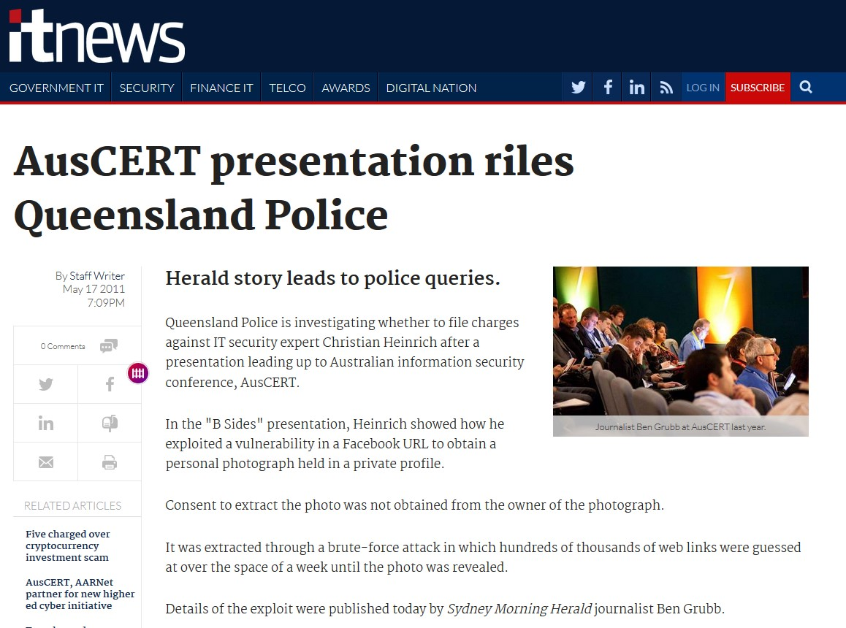
Some past breaches
Any breach involving downloads from S3 buckets or open directories
Facebook 210 m phone numbers from US, UK and Vietnam
Photo album privacy issue (AusCert 2011)

Slide 251
12.1.1 Enforce a file size limit
Verify that the application will not accept large files that could fill up storage or cause a denial of service attack.
Rationale
Prevent users uploading movies, extremely large blobs
Reduce risk of running out of storage
Reduce cloud storage costs
Relevant standards
NIST 800-53 SI-3
Recommended solutions
Enforce a file size limit
Unit Tests
Test files less than the limit: pass
Test files >= file size limit: fail
End to end integration tests
Test files less than the limit: pass
Test files >= file size limit: fail

Slide 252
12.1.2 Caution with extracting compressed files
Verify that compressed files are checked for "zip bombs" - small input files that will decompress into huge files thus exhausting file storage limits.
Rationale
Zip Bombs are well known
SecLists contains at least one
Relevant standards
NIST 800-53 SI-3
Recommended solutions
Scan uploaded files with AV libraries
Be cautious of accepting compressed files
Unit Tests
Upload a zip bomb
Pass: rejects upload
Fail: runs out of disk space, never returns
End to end integration tests
Upload a zip bomb
Pass: rejects upload
Fail: runs out of disk space, never returns
PHP test zip:// bzip2:// zlib:// filters

Slide 253
12.1.3 Prevent big cloud storage bills
Verify that a file size quota and maximum number of files per user is enforced to ensure that a single user cannot fill up the storage with too many files, or excessively large files.
Rationale
Attack costs of storing on cloud
Relevant standards
NIST 800-53 SI-3
Recommended solutions
Implement per user file quotas
Monitor bucket / storage costs
Unit Tests
Test file quota enforcement
End to end integration tests
Upload many large files
Pass: should block once limit reached
Fail: allows user to go over quota

Slide 254
12.2.1 Check expected file contents
Verify that files obtained from untrusted sources are validated to be of expected type based on the file's content.
Rationale
Users can say anything is a JPG file
GIFARs
Relevant standards
NIST 800-53 SI-3
Recommended solutions
Use file or /usr/share/misc/magic to determine the file type
Graceful error handling
Unit Tests
Test file upload functionality for:
Files which are the correct type
Files which are not correct type
Files which might crash the application
End to end integration tests
Attempt to upload a file claiming to be a supported file type, but is not

Slide 255
12.3.1 Path traversal
Verify that user-submitted filename metadata is not used directly with system or framework file and URL API to protect against path traversal.
Rationale
Path traversal allows access to sensitive files
Poor file handling leads to path traversal, SSRF, and internal port scanning
Relevant standards
NIST 800-53 SI-3
Recommended solutions
Decompose filenames and URLs
Validate all portions using positive validation
Ensure basename and directory names are still within your preferred storage bucket or directory
Consider using a walled file service
Unit Tests
Test file metadata with hostile payloads:
Path traversal filenames
-ve, 0, n, huge sizes
SQL injection and other payloads for file types and so on
End to end integration tests
Fuzz test file upload functionality using Zap or Burp

Slide 256
12.3.2 User supplied file metadata might allow local file inclusion
Verify that user-submitted filename metadata is validated or ignored to prevent the disclosure, creation, updating or removal of local files (LFI).
Rationale
Path traversal
Local file inclusion
SecLists payloads
DAST scanners
Relevant standards
NIST 800-53 SI-3
Recommended solutions
Decompose filenames and URLs
Validate all portions using positive validation
Consider strongly not using supplied metadata with OS / file API
Unit Tests
Test file metadata with hostile payloads:
Path traversal filenames
-ve, 0, n, huge sizes
SQL injection and other payloads for file types and so on
End to end integration tests
Fuzz test file upload functionality using Zap or Burp

Slide 257
12.3.3 User supplied file metadata might allow remote file inclusion or SSRF
Verify that user-submitted filename metadata is validated or ignored to prevent the disclosure or execution of remote files (RFI), which may also lead to SSRF.
Rationale
RFI and SSRF are well know today
Tools can easily test for RFI/SSRF
Relevant standards
OWASP Top 10 2017:AR
NIST 800-53 SI-3
Recommended solutions
Decompose filenames and URLs
Validate all portions using positive validation
Consider strongly not using supplied metadata with OS / file API
Unit Tests
Test file metadata with hostile payloads:
Path traversal filenames
-ve, 0, n, huge sizes
SQL injection and other payloads for file types and so on
End to end integration tests
Fuzz test file upload functionality using Zap or Burp

Slide 258
12.3.5 User supplied file metadata might lead to OS command injection
Verify that untrusted file metadata is not used directly with system API or libraries, to protect against OS command injection.
Rationale
Metadata is not easily UAT tested
Testing tools can adjust all of these values
Relevant standards
NIST 800-53 SI-3
Recommended solutions
Validate but do not use these values directly
Unit Tests
Test file metadata with hostile payloads:
Path traversal filenames
-ve, 0, n, huge sizes
SQL injection and other payloads for file types and so on
End to end integration tests
Fuzz test file upload functionality using Zap or Burp

Slide 259
12.3.6 Verified components only
Verify that the application does not include and execute functionality from untrusted sources, such as unverified content distribution networks, JavaScript libraries, node npm libraries, or server-side DLLs.
Rationale
Untrusted libraries can compromise securely developed applications
Relevant standards
NIST 800-53 SI-3
Recommended solutions
Vet the source of repositories
Use a dependency tracker to ensure that the latest versions are in place
Unit Tests
Not testable
End to end integration tests
Not testable

Slide 260
12.4.1 Store files outside the webroot
Verify that files obtained from untrusted sources are stored outside the web root, with limited permissions, preferably with strong validation.
Rationale
Web Shells
Malicious attachments
Relevant standards
NIST 800-53 SI-3
Recommended solutions
Use bucket, database, directory outside the webroot, or a file store
Unit Tests
Upload files: confirm that the persisted file is not within the webroot
End to end integration tests
Not testable

Slide 261
12.4.2 Scan uploaded files
Verify that files obtained from untrusted sources are scanned by antivirus scanners to prevent upload of known malicious content.
Rationale
Most malware is off the shelf
Some users are not aware they are infected
Custom malware is easy to produce
Relevant standards
NIST 800-53 SI-3
Recommended solutions
Scan files with an AV library
Send a SHA256 hash to Virus Total
Unit Tests
Upload normal file: should pass
Upload EICAR: should fail
End to end integration tests
Same as unit tests

Slide 262
12.5.1 Permit access only to known file types
Verify that the web tier is configured to serve only files with specific file extensions to prevent unintentional information and source code leakage. For example, backup files (e.g. .bak), temporary working files (e.g. .swp), compressed files (.zip, .tar.gz, etc) and other extensions commonly used by editors should be blocked unless required.
Rationale
Content discovery by DAST scanners
Google Dorking
Relevant standards
NIST 800-53 SI-3
Recommended solutions
Harden web server configuration
Harden application server configuration
Use a WAF
Unit Tests
Not applicable
End to end integration tests
Not applicable

Slide 263
12.5.2 Protect uploaded files from direct access
Verify that direct requests to uploaded files will never be executed as HTML/JavaScript content.
Rationale
Web shells and backdoors
Data exfiltration
Excessive downloads
Relevant standards
NIST 800-53 SI-3
Recommended solutions
Place file buckets outside of the webroot
Enforce access controls
Allow file downloads as multi-part octet streams
Unit Tests
Test that users have access to files
Test delivery of octet-streams
End to end integration tests
Try using path traversal to the path of the file bucket / directory: should fail

Slide 264
12.6.1 Implement network whitelisting
Verify that the web or application server is configured with a whitelist of resources or systems to which the server can send requests or load data/files from.
Rationale
Attackers expect easy exfiltration
Most firewalls are strict inbound
Most firewalls are lax outbound
Relevant standards
NIST 800-53 SI-3
Recommended solutions
Use a positive network filter for new outbound connections
If you don’t need outbound connectivity, don’t allow outbound
Monitor outbound connection attempts
Unit Tests
Try to make an unauthorized connection to an external resource
Should fail
End to end integration tests
Same as unit tests, using SSRF or similar attack

Slide 265
Files and Resources Lab

Slide 266
V13 Web Services Security

Slide 267

What is Web Service Security
RESTful, server-less (functions), and SOAP based security
Covers primarily REST
SOAP still very prevalent in ESBs and large enterprises
WS-Security* solves a lot of open problems in RESTful security

Slide 268

Some past breaches
Venmo API breach
7 m transactions
Lenovo / EMC storage API
36 TB of files exposed
Shopify
Thousands of stores revenue data exposed
This Photo by Unknown Author is licensed under CC BY-SA-NC

Slide 269
13.1.1 Protect against SSRF and RFI
Verify that all application components use the same encodings and parsers to avoid parsing attacks that exploit different URI or file parsing behavior that could be used in SSRF and RFI attacks.
Rationale
SSRF and RFI are well known
Easily tested using OWASP Zap or Burp
Relevant standards
OWASP Top 10 (all of it)
OWASP Proactive Controls (all of it)
PCI DSS 6.5.* (most of it)
NIST 800-53 AC SI SC SA IA CM
Recommended solutions
Decompose filenames and URLs
Validate all portions using positive validation
Consider strongly not using supplied metadata with OS / file API
Unit Tests
Test file metadata with hostile payloads:
Path traversal filenames
-ve, 0, n, huge sizes
SSRF, RFI, SQL injection and other payloads for file types and so on
End to end integration tests
Fuzz test file upload functionality using Zap or Burp, especially for SSRF and RFI

Slide 270
13.1.2 Administrator access control
Verify that access to administration and management functions is limited to authorized administrators.
Rationale
Access control is about who you are, not where you are
Internal, unmaintained applications provide false sense of security
Relevant standards
OWASP Top 10 (all of it)
OWASP Proactive Controls (all of it)
PCI DSS 6.5.* (most of it)
NIST 800-53 AC SI SC SA IA CM
Recommended solutions
Admin API should require MFA authentication
Ensure that administration API is enforcing RBAC for admins
Unit Tests
Try to use admin API:
Anonymous users: fail
Normal non-MFA user: fail
Normal user with MFA: fail
Administrator w/out MFA: fail
Administrator with MFA: pass
End to end integration tests
Same as unit tests

Slide 271
13.1.3 API keys not in URLs
Verify API URLs do not expose sensitive information, such as the API key, session tokens etc.
Rationale
API keys are the same as username + password
Relevant standards
OWASP Top 10 (all of it)
OWASP Proactive Controls (all of it)
PCI DSS 6.5.* (most of it)
NIST 800-53 AC SI SC SA IA CM
Recommended solutions
JWT, SAML, OAuth
Unit Tests
If any API takes an URL API Key parameter:
Warn if many such functions
Error (break the build) if few
End to end integration tests
Same as Unit tests

Slide 272
13.1.4 Access control on trusted layers
Verify that authorization decisions are made at both the URI, enforced by programmatic or declarative security at the controller or router, and at the resource level, enforced by model-based permissions.
Rationale
Access controls can be bypassed outside of trusted service layers
Relevant standards
OWASP Top 10 (all of it)
OWASP Proactive Controls (all of it)
PCI DSS 6.5.* (most of it)
NIST 800-53 AC SI SC SA IA CM
Recommended solutions
Use JWT, SAML assertions
Enforce at the controller, and at relevant layers
Unit Tests
Accessing the API: router/controller
Accessing specific records: model
Accessing business logic: domain
End to end integration tests
Test for anonymous users, users without the sufficient roles, and users with sufficient privileges

Slide 273
13.2.1 RESTful methods correctly used
Verify that enabled RESTful HTTP methods are a valid choice for the user or action, such as preventing normal users using DELETE or PUT on protected API or resources.
Rationale
Bypass access controls
GET should not act as PUT or DELETE
Relevant standards
OWASP Top 10 (all of it)
OWASP Proactive Controls (all of it)
PCI DSS 6.5.* (most of it)
NIST 800-53 AC SI SC SA IA CM
Recommended solutions
Ensure for languages where there is no distinction between GPCES, that the method is used to distinguish privileges actions (POST, PUT, DELETE)
Unit Tests
Try to delete records using ~ DELETE
Try to create new records using ~ PUT
Try to modify records using ~ POST
Try to get records using ~ GET
End to end integration tests
Same as Unit Tests

Slide 274
13.2.2 Validate incoming JSON
Verify that JSON-Schema validation is in place and verified before accepting input.
Rationale
JSON can contain hostile inputs
Relevant standards
OWASP Top 10 (all of it)
OWASP Proactive Controls (all of it)
PCI DSS 6.5.* (most of it)
NIST 800-53 AC SI SC SA IA CM
Recommended solutions
Review https://json-schema.org
Consider if necessary
Unit Tests
Test with malformed JSON
JSON with extra information
Test correct JSON
End to end integration tests
Test with malformed JSON
JSON with extra information
Test correct JSON

Slide 275
13.2.3 CSRF Protection
Verify that RESTful web services that utilize cookies are protected from Cross-Site Request Forgery via the use of at least one or more of the following: triple or double submit cookie pattern, CSRF nonces, or ORIGIN request header checks.
Rationale
CSRF for cookie based web services is still possible
Relevant standards
OWASP Top 10 (all of it)
OWASP Proactive Controls (all of it)
PCI DSS 6.5.* (most of it)
NIST 800-53 AC SI SC SA IA CM
Recommended solutions
If using cookie-based authentication, CSRF protection is required
Enforce at the controller (or a filter)
Header based web services are already protected
Unauthenticated API don’t need CSRF protection
Unit Tests
Test without a CSRF token: fail
Test with a CSRF token: pass
End to end integration tests
Test without a CSRF token: fail
Test with a CSRF token: pass

Slide 276
13.2.4 API Anti-automation
Verify that REST services have anti-automation controls to protect against excessive calls, especially if the API is unauthenticated.
Rationale
APIs are designed for B2B and automation
Abuse is still a problem (scraping, disclosure, etc)
Relevant standards
OWASP Top 10 (all of it)
OWASP Proactive Controls (all of it)
PCI DSS 6.5.* (most of it)
NIST 800-53 AC SI SC SA IA CM
Recommended solutions
API Gateways – technical limits
OWASP Automated Threat Handbook
Unit Tests
Attempt to obtain all records
Should fail
End to end integration tests
Attempt to sign up, login, lockout, or obtain all users’ data
Should fail

Slide 277
13.3.1 SOAP – Schema validation
Verify that XSD schema validation takes place to ensure a properly formed XML document, followed by validation of each input field before any processing of that data takes place.
Rationale
Data should be validated before use
XSD replaces DTD validation
xsd:string == no validation
Relevant standards
OWASP Top 10 (all of it)
OWASP Proactive Controls (all of it)
PCI DSS 6.5.* (most of it)
NIST 800-53 AC SI SC SA IA CM
Recommended solutions
Xerces and other implementations
Consider if necessary
Unit Tests
Test with malformed XML
XML with extra information
Test correct XML
End to end integration tests
Test with malformed XML
XML with extra information
Test correct XML

Slide 278
13.3.2 SOAP WS-Security Confidentiality
Verify that the message payload is signed using WS-Security to ensure reliable transport between client and service.
Rationale
Solves many RESTful security issues
Relevant standards
OWASP Top 10 (all of it)
OWASP Proactive Controls (all of it)
PCI DSS 6.5.* (most of it)
NIST 800-53 AC SI SC SA IA CM
Recommended solutions
Use TLS
Sign messages using WS-Security
Unit Tests
Not testable
End to end integration tests
Ensure that connections are over TLS
Test a signed message: pass
Test an unsigned message: fail

Slide 279
13.4.1 GraphQL Expression DoS
Verify that query whitelisting or a combination of depth limiting and amount limiting should be used to prevent GraphQL or data layer expression denial of service (DoS) as a result of expensive, nested queries. For more advanced scenarios, query cost analysis should be used.
Rationale
Has many of the same attributes as SQL servers, but field / JSON based
Relevant standards
OWASP Top 10 (all of it)
OWASP Proactive Controls (all of it)
PCI DSS 6.5.* (most of it)
NIST 800-53 AC SI SC SA IA CM
Recommended solutions
Go to Ahbay Bhargav’s talk on GraphQL security
Unit Tests
Test various GraphQL expressions
Infinite loop
Selects all records
Performs complex expressions
End to end integration tests
Test various GraphQL expressions
Infinite loop
Selects all records
Performs complex expressions

Slide 280
13.4.2 GraphQL Access Control
Verify that GraphQL or other data layer authorization logic should be implemented at the business logic layer instead of the GraphQL layer.
Rationale
Upcoming data access technology
Has many of the same attributes as SQL servers, but field / JSON based
Relevant standards
OWASP Top 10 (all of it)
OWASP Proactive Controls (all of it)
PCI DSS 6.5.* (most of it)
NIST 800-53 AC SI SC SA IA CM
Recommended solutions
Implement GraphQL access control on a trusted layer
Unit Tests
Test that GraphQL requires authentication and role-based security to use
End to end integration tests
Try to execute valid GraphQL queries with authentication: pass
Without authentication: fail
With appropriate access tokens: pass
With missing access control: fail

Slide 281
API Security Lab

Slide 282
V14 Configuration
Nearly done!

Slide 283
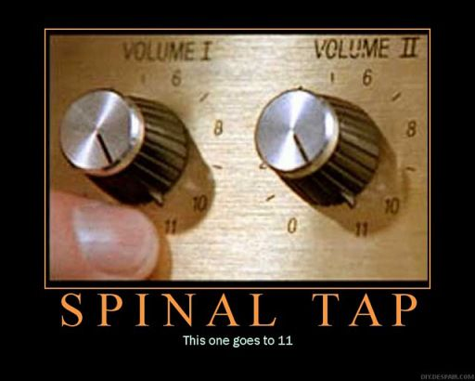
What is Configuration Security
Common set of mistakes
Outdated components
Web Server
Application Server
Database Server(s)
Serverless / Cloud configuration
File permissions and so on

Slide 284
Some past breaches
Equifax – 147m records
RCA – insufficient patching of outdated software
Capital One – 100 m records
Cloud config issue
CEH Breach – 60k IDs
Config issue (1st hack)
Password re-use (2nd hack)

Slide 285
14.2.1 Dependency checks every build
Verify that all components are up to date, preferably using a dependency checker during build or compile time.
Rationale
Outdated software bugs
Vulnerable software shouldn’t be in production
Bug Gapping
Relevant standards
OWASP Top 10 A9
OWASP Proactive Controls C2
PCI DSS 6.5.6
NIST 800-53 SI
Recommended solutions
OWASP Dependency Check
OWASP Dependency Tracker
BlackDuck, SonarCube
Unit Tests
None
End to end integration tests
None
Build Step
Builds should warn if out of date
Builds must fail if vulnerable

Slide 286
14.2.2 Deploy only what’s necessary
Verify that all unneeded features, documentation, samples, configurations are removed, such as sample applications, platform documentation, and default or example users.
Rationale
Reduce attack surface
Harden configuration
Relevant standards
OWASP Top 10 A9
OWASP Proactive Controls C2
PCI DSS 6.5.6
NIST 800-53 SI
Recommended solutions
Automate builds using Ansible, Docker, etc
Find extraneous stuff in documentation and builds and remove it in the build script
Unit Tests
Not applicable
End to end integration tests
Not applicable
Build tests
Review finished builds for detritus, change the script
Rinse and repeat until clean

Slide 287
14.2.3 Subresource integrity
Verify that if application assets, such as JavaScript libraries, CSS stylesheets or web fonts, are hosted externally on a content delivery network (CDN) or external provider, Subresource Integrity (SRI) is used to validate the integrity of the asset.
Rationale
Allows use of edge networks / CDNs
Allows safer use of assets where you can’t see if they are being attacked
Relevant standards
OWASP Top 10 A9
OWASP Proactive Controls C2
PCI DSS 6.5.6
NIST 800-53 SI
Recommended solutions
Configure sub-resource integrity for every script include and asset
Configure CSP to cover just these CDNs
Ensure that users cannot force the choice of older libraries (such as Google API or CF CDN)
Unit Tests
Not applicable
End to end integration tests
Ensure that sub-resource integrity signatures are included
Ensure that assets are correctly loaded

Slide 288
14.3.1 User friendly error messages
Verify that web or application server and framework error messages are configured to deliver user actionable, customized responses to eliminate any unintended security disclosures.
Rationale
Detailed error messages help attackers
Users can’t usually make heads or tails of detailed errors
Relevant standards
OWASP Top 10 A9
OWASP Proactive Controls C2
PCI DSS 6.5.6
NIST 800-53 SI
Recommended solutions
Build out custom error messages that are actionable by the end users
Send detailed exceptions, etc to logs for later analysis
Unit Tests
Not applicable
End to end integration tests
Try to force an error
Custom error page: pass
Exception page: fail

Slide 289
14.3.2 Production means production
Verify that web or application server and application framework debug modes are disabled in production to eliminate debug features, developer consoles, and unintended security disclosures.
Rationale
Disable debug mode
Production builds (even for webpack)
Relevant standards
OWASP Top 10 A9
OWASP Proactive Controls C2
PCI DSS 6.5.6
NIST 800-53 SI
Recommended solutions
Build debug and production builds
Debug – has consoles, no minification, and debug logging
Production – no consoles, full minification, no debug logging
Unit Tests
Not applicable
End to end integration tests
Attempt to open debug consoles
Attempt to force the logging of a debug canary

Slide 290
14.3.3 Remove marketing headers
Verify that the HTTP headers or any part of the HTTP response do not expose detailed version information of system components.
Rationale
Marketing headers help OS vendors, not you
Only Alexa, marketers, and attackers use this information
Relevant standards
OWASP Top 10 A9
OWASP Proactive Controls C2
PCI DSS 6.5.6
NIST 800-53 SI
Recommended solutions
Configure the WAF to remove these headers
Configure the web server to disable these headers
Unit Tests
Not applicable
End to end integration tests
Test that marketing headers have been removed

Slide 291
14.4.1 Set a safe content type
Verify that every HTTP response contains a content type header specifying a safe character set (e.g., UTF-8, ISO 8859-1).
Rationale
Might be able to convince older browsers to include XSS from another character set
Relevant standards
OWASP Top 10 A9
OWASP Proactive Controls C2
PCI DSS 6.5.6
NIST 800-53 SI
Recommended solutions
Use UTF-8
Unit Tests
Not applicable
End to end integration tests
Ensure that a suitable character set is used, preferably UTF-8

Slide 292
14.4.2 Set a safe API content type
Verify that all API responses contain Content-Disposition: attachment; filename="api.json" (or other appropriate filename for the content type).
Rationale
Prevents the use of API responses for HTML XSS
Relevant standards
OWASP Top 10 A7
OWASP Proactive Controls C2
PCI DSS 6.5.7
NIST 800-53 SI
Recommended solutions
Set an appropriate content disposition header
Unit Tests
Not applicable
End to end integration tests
Test that the application sends an appropriate content-disposition header

Slide 293
14.4.3 Set a Content Security Policy
Verify that a content security policy (CSPv2) is in place that helps mitigate impact for XSS attacks like HTML, DOM, JSON, and JavaScript injection vulnerabilities.
Rationale
CSP prevents most XSS
CSP makes CSRF harder
CSP protects against include attacks
Relevant standards
OWASP Top 10 A9
OWASP Proactive Controls C2
PCI DSS 6.5.6
NIST 800-53 SI
Recommended solutions
Set a minimal content security policy header
If third party sites are not used, include “frame-ancestors”
Unit Tests
Not applicable
End to end integration tests
Test that a CSP header is present

Slide 294
14.4.5 Ensure only TLS
Verify that HTTP Strict Transport Security headers are included on all responses and for all subdomains, such as Strict-Transport-Security: max-age=15724800; includeSubdomains.
Rationale
Forces browsers to always use TLS
Stops attackers downgrading comms
Relevant standards
OWASP Top 10 A9
OWASP Proactive Controls C2
PCI DSS 6.5.6
NIST 800-53 SI
Recommended solutions
Set a strict transport security header
Configure the web server to only redirect from unencrypted ports
Unit Tests
Not applicable
End to end integration tests
Test that a strict transport security header is set

Slide 295
14.4.6 Limit referer disclosure
Verify that a suitable "Referrer-Policy" header is included, such as "no-referrer" or "same-origin".
Rationale
Only marketers use this information
Attackers attack marketers
Attackers know all about you
Relevant standards
OWASP Top 10 A9
OWASP Proactive Controls C2
PCI DSS 6.5.6
NIST 800-53 SI
Recommended solutions
Set a referrer policy header, preferably no referrer
Unit Tests
Not applicable
End to end integration tests
Test that the Referer-Policy header is present and set to the appropriate value

Slide 296
14.5.2 Don’t trust Origin headers
Verify that the supplied Origin header is not used for authentication or access control decisions, as the Origin header can easily be changed by an attacker.
Rationale
Origin headers are attacker controlled
Reflecting or trusting Origin headers is extremely unwise and will lead to exploitation
Relevant standards
OWASP Top 10 A9
OWASP Proactive Controls C2
PCI DSS 6.5.6
NIST 800-53 SI
Recommended solutions
Use a strict ACAO header
Unit Tests
Test that the Origin request parameter is not echoed to the ACAO header
End to end integration tests
Test that the Origin request parameter is not echoed to the ACAO header

Slide 297
14.5.3 Use known ACAO headers
Verify that the cross-domain resource sharing (CORS) Access-Control-Allow-Origin header uses a strict white-list of trusted domains to match against and does not support the "null" origin.
Rationale
Misconfigured CORS is a popular bug bounty finding
Can bypass access controls
Relevant standards
OWASP Top 10 A5 A6
OWASP Proactive Controls C2
PCI DSS 6.5.6
NIST 800-53 SI
Recommended solutions
Use a strict ACAO header
Unit Tests
Test that the ACAO header is present and one of the permitted values
End to end integration tests
Test that the ACAO header is present and one of the permitted values

Slide 298
Demo and Labs
cvedetails.com
Finding out if we’re using the latest components

Slide 299
Tournament
Compete against yourself or everyone in the room!

Slide 300
Objective – Find all the bugs!
Tournament has exercises in a bunch of languages and frameworks
Points are awarded for fixing code
Teaming up is absolutely fine!
Try to combine skills in multiple languages and frameworks
Testing is just as important as coding
Join code
3492 4588

Slide 301
References

Slide 302

https://owasp.org

Slide 303
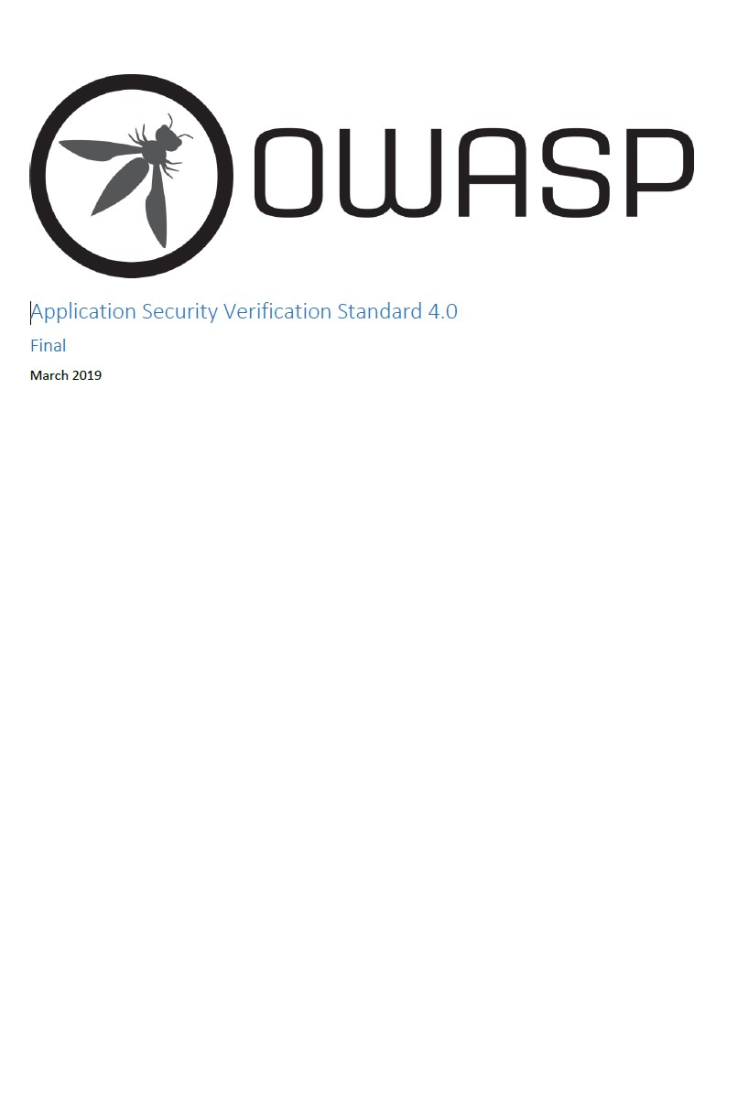
OWASP Application Security Verification Standard
Get it here:
https://www.owasp.org/index.php/Category:OWASP_Application_Security_Verification_Standard_Project
Fork it here:
https://github.com/OWASP/ASVS

Slide 304
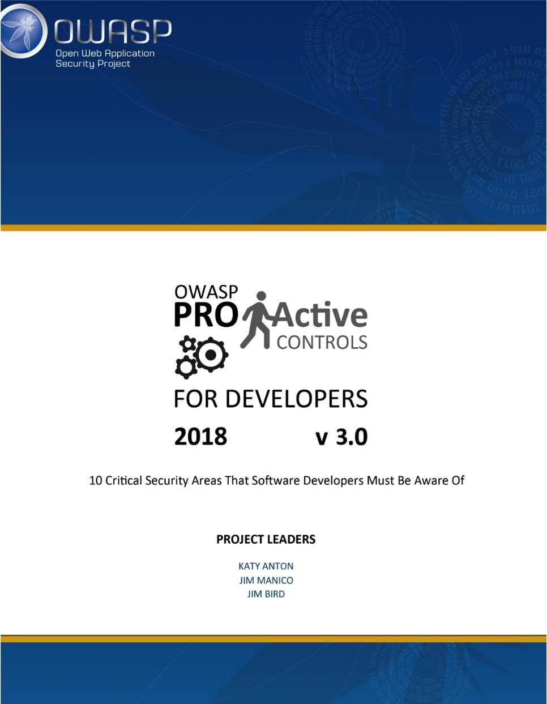
OWASP Proactive Controls
Get it or translate it here:
https://www.owasp.org/index.php/OWASP_Proactive_Controls

Slide 305

OWASP Cheat Sheets
Get it here:
https://cheatsheetseries.owasp.org/
Fork it here:
https://github.com/OWASP/CheatSheetSeries

Slide 306

OWASP Top 10 2017
Get Top 10 2017 here:
https://github.com/OWASP/Top10
Fork or translate it here:
https://github.com/OWASP/Top10
Top 10 2020 will be released Q3 2020

Slide 307
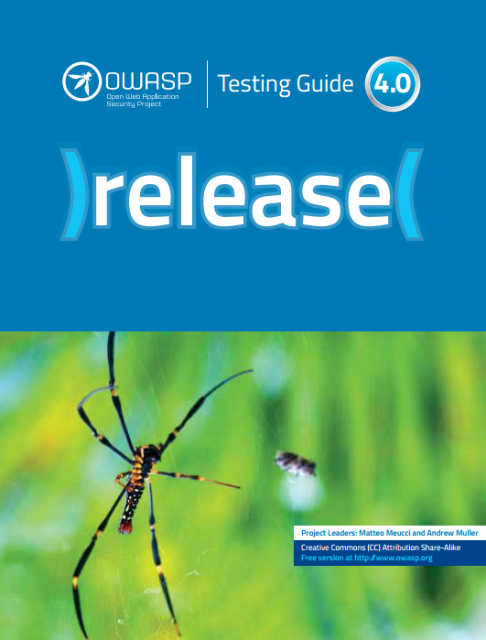
OWASP Testing Guide v4
Get it here:
https://www.owasp.org/index.php/OWASP_Testing_Project

Slide 308
OWASP Dependency Checker
Get it here:
https://www.owasp.org/index.php/OWASP_Dependency_Check
Fork it here:
https://github.com/jeremylong/DependencyCheck

Slide 309
OWASP Zap
Get it here:
https://www.owasp.org/index.php/OWASP_Zed_Attack_Proxy_Project
Fork it here:
https://github.com/zaproxy/zaproxy/

Slide 310
Wrapping up

Slide 311
Thank you!
Andrew van der Stock
vanderaj@owasp.org
@vanderaj
1 510 697 9315

Slide 312

Copyright notice and license
Copyright © 2008 – 2019 The OWASP Foundation.
This document is released under the Creative Commons Attribution ShareAlike 3.0 license. For any reuse or distribution, you must make clear to others the license terms of this work.

Slide 313
OWASP Brand Usage Guidelines
The Open Web Application Security Project (OWASP) is a 501(c)(3) worldwide not-for-profit charitable organization focused on improving the security of software.
Our mission is to make software security visible, so that individuals and organizations worldwide can make informed decisions about true software security risks.
Everyone is free to participate in OWASP and all of our materials are available under a free and open software license. You'll find everything about OWASP linked from our wiki and current information on our OWASP Blog.
OWASP does not endorse or recommend commercial products or services, allowing our community to remain vendor neutral with the collective wisdom of the best minds in software security worldwide. We ask that the community look out for inappropriate uses of the OWASP brand including use of our name, logos, project names and other trademark issues.
https://owasp.org

